Slide 1
Introduction to Computational Thinking
Interactive Programs
Define an “interactive program”
Describe two strategies for creating an interactive program.
Add interactive features to an existing non-interactive program.

Slide 2
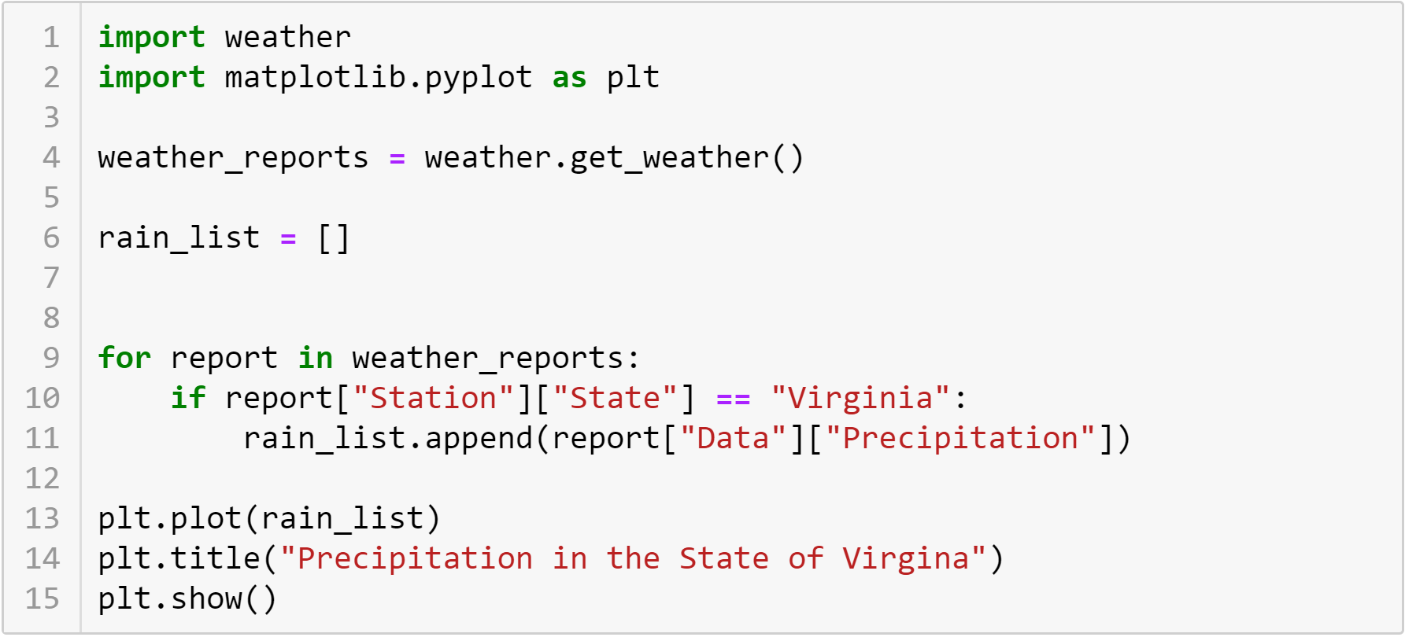
What does this do?

Slide 3
Programs
Single purpose programs
Always perform the same computation.
Provide the same output
Useful for answering a single, fixed question.
Interactive programs
Allows the user some control over the computation
Each run may produce different output
Is a tool for exploration of the answer to different questions

Slide 4
What makes this single purpose?
Only uses a State named Virginia
Only reports on rainfall
Only draws a line plot

Slide 5
Strategies
Adding variables
Replacing a fixed literal value with a value input from the user
Literal values in a condition
Keys in a dictionary
Adding options
Adding a decision to select between alternatives (e.g., visualizations, units)
Input from the user controls which alternative is selected

Slide 6
Demonstration
Adding interactivity to a single-purpose program.

Slide 7
To do
Work on Classwork problems

