Slide 1
Introduction to Computational Thinking
Visualizing Complex Data
Explain the concept of “layers of abstraction.”
Create a map of a data structure with layers of abstraction.
Write algorithms that compute quantitative measures and visualizations for data with layers of abstraction.

Slide 2
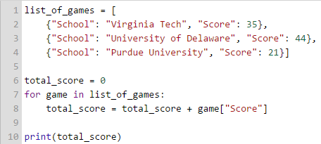
Review
With a list → iterate through each element
for <item> in <list>:
<list> is a list of dictionaries
<item> becomes a dictionary property
With a dictionary → use a key to access a value
value = dictionary["key"]

Slide 3
Layers of Abstraction
Many properties are often needed to make our abstractions of the real world accurate.
Sunny?
Dew Point
Temperature
Precipitation
Barometer
City Name
Humidity
Wind Direction
Day
State
Visibility
Location
Wind Speed
Weather
Month
Date
Heat Index
Year
Raining?

Slide 4
An Abstraction
City | State | Temperature | Month | Hour | Min | Sec | Humidity | Wind | Day | Zip | Year
Humans are not "wired" to handle many properties at one time (our short term memory allows about 7 +/- 1 things)
So we group together related properties to form named sub-abstractions
An entity is represented by few properties some of which are sub-abstractions
Each sub-abstraction is represented by a few properties some of which may be sub-abstractions
Each sub-abstraction is ….

Slide 5
Layers of Abstraction
Place | Report | Date
. . . | . . . | . . .
Temperature | Humidity | Wind
76 | 55 | 18
City | State | Zip
Blacksburg | VA | 24061
Month | Day | Year | Time
May | 20 | 2015
Hour | Min | Sec
11 | 32 | 52

Slide 6
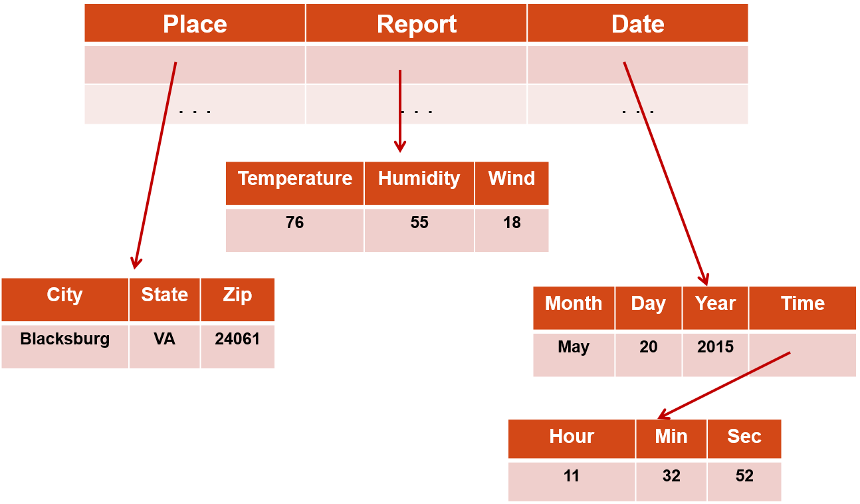
Representing Layers
{“Place” : … , “Report” : … , “Date” : … }
{“City”: “Blacksburg”, “State”: ”VA”, “Zip”: 24061}
{“Temperature”: 76, “Humidity”: 55, “Wind”: 18}

Slide 7
Accessing a value
forecast =
where
To find the Zip code:
where = forecast["Place"]
zipcode = where["Zip"]
or just
zipcode = forecast["Place"]["Zip"]
To find the Hour:
when = forecast["Date"]["Time"]["Hour"]

Slide 8
Demonstration
Mapping the earthquakes data stream
Using Explore Structure button for a CORGIS data set

Slide 9
Mapping diagram: Tree

Slide 10
Mapping diagram: Outline
reports [{}]
‘id’ : string
‘impact’ {}
‘gap’ : float
‘magnitude’ : float
‘significance’ : int
‘location’ { }
‘depth’ : float
…
‘latitude’: float
‘longitude’ : float
‘state’ : string
‘time’ : …

Slide 11
Mapping Diagrams
Now do Classwork Question 1
Today and for your project, you’ll be making your own diagram
Use any of the diagram types shown before, whichever makes the most sense to you.

Slide 12
Map to Code
Iterate with For loop
First Dictionary access with key
Starting point
Second Dictionary access with key
End goal

Slide 13
Map to Code
import earthquakes
list_of_earthquakes = earthquakes.get_earthquakes()
for earthquake in list_of_earthquakes:
earthquake["impact"]["magnitude"]
Iterate with For Loop
First dictionary access
Second dictionary access

Slide 14
Summing magnitudes
import earthquakes
list_of_earthquakes = earthquakes.get_earthquakes()
sum = 0
for earthquake in list_of_earthquakes:
sum = sum + earthquake["impact"]["magnitude"]
print(sum)

Slide 15
More classwork
Now do Classwork Question 2 and 3

Slide 16
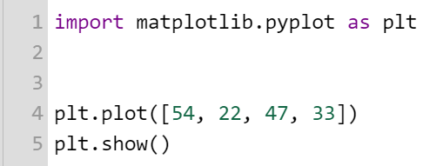
Plotting
Import! We’ll talk more about this later.

Slide 17
Functions in 3 easy steps
Step 1: functions have names
plt.show()
Step 2: functions may have parameters
plt.plot(data)
Step 3: functions may return a value
reports = weather.get_reports()
Notes
The user documentation tells you what a function does and what you need to use it
You do not need to know how a function is implemented to use it (and you often don’t care)
Reusing functions is a highly valued professional practice

Slide 18
Four simple visualizations
Name | Function Name | Typical Usage
Line plot | plt.plot(x) | Change over time
Scatter plot | plt.scatter(x,y) | Relationship between two lists
Histogram | plt.hist(x) | Distribution of a list
Bar chart | plt.bar(x, y) | Comparison between categories
Bar charts are just a little trickier, don’t worry about them yet.

Slide 19
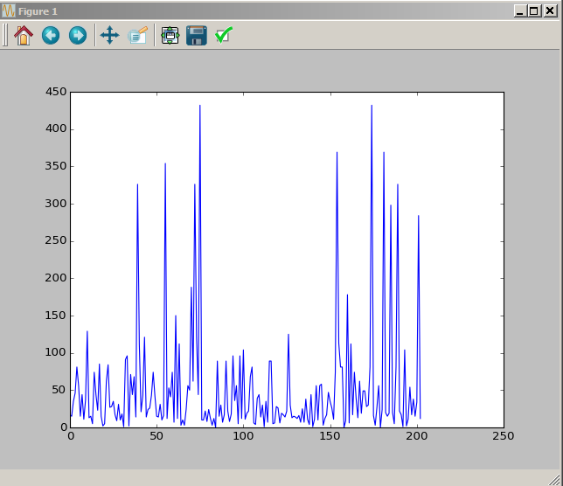
Line plot visualizations
Question: How does earthquake significance change over time?
import earthquakes
import matplotlib.pyplot as plt
# get all the reports of earthquakes
quakes = earthquakes.get_earthquakes()
# create an empty list
significance_list = []
for quake in quakes:
# add the significance of the next earthquake to the list
significance_list.append(quake["significance"])
plt.plot(significance_list)
plt.show()

Slide 20
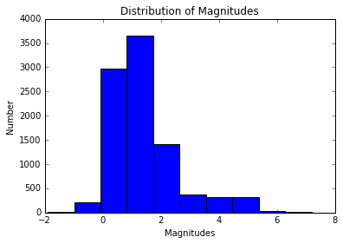
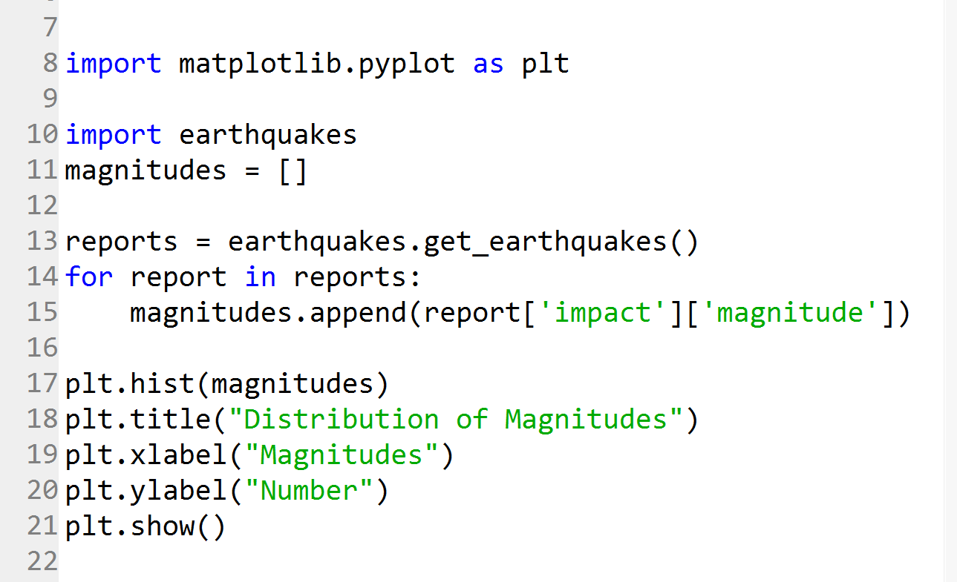
Titles and Labels
Be sure to title each visualization and label the two axes.

Slide 21
To do
Work on class assignments
Finish it all
Self-assess
Are you solid on the concepts?
Properties, Keys, Values
Lists of Dictionaries of Dictionaries
Creating Plots from Layered Data
Are you up to date on classwork and homework?
If not, catch up, come see us!

