Slide 1
Introduction to Computational Thinking
Abstraction &
Data Structures (2)
Construct a data structure to represent a complete abstraction.
Analyze and write algorithms combining lists, dictionaries, and iteration.

Slide 2
Today’s Plan
Discuss
dictionary
list of dictionaries
Take Dictionary Practice Quiz (10 minutes)
Low pressure: you can (re)take this 3 times, even after the discussion/class
Discussion of Quiz
Classwork problems
Last 25 minutes of class
Dictionary Post-Quiz 1
Dictionary Post-Test

Slide 3
Where we are …
Combining lists and dictionaries!
Using iteration on the combination!

Slide 4
Combining lists and dictionaries
Lists and dictionaries are two forms of data structures – different schemes to organize and access data
Representing the abstractions of complex real-world artifacts often requires some combination of these data structures
Combining simple structures to form more complex ones

Slide 5
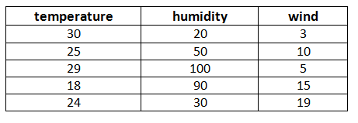
List of dictionaries
A weather report abstraction has three properties
temperature
humidity
wind
A weather forecast is a collection of instance of weather reports

Slide 6
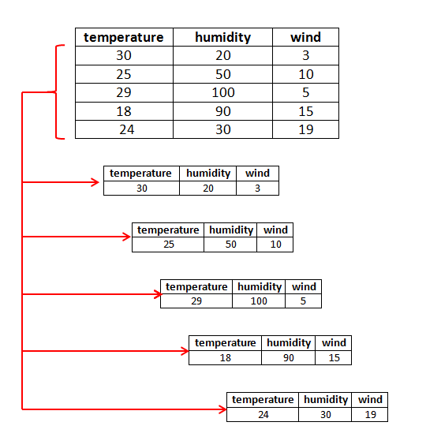
A collection of dictionaries
Each instance of a weather report in the weather forecast can be represented separately
Each instance of a weather report can be represented as a dictionary
{ “temperature”: 30, “humidity”: 20, “wind”: 3 }

Slide 7
A list of dictionaries
The individual weather report instances (dictionaries) can be collectively represented in a list
{ 'temperature': 24, 'humidity': 30, 'wind': 19 }
{ 'temperature': 18, 'humidity': 90, 'wind': 15 }
{ 'temperature': 29, 'humidity': 100, 'wind': 5 }
{ 'temperature': 25, 'humidity': 50, 'wind': 10 }
{ 'temperature': 30, 'humidity': 20, 'wind': 3 }

Slide 8
List/dictionary in Python
{ 'temperature': 24, 'humidity': 30, 'wind': 19 }
{ 'temperature': 18, 'humidity': 90, 'wind': 15 }
{ 'temperature': 29, 'humidity': 100, 'wind': 5 }
{ 'temperature': 25, 'humidity': 50, 'wind': 10 }
{ 'temperature': 30, 'humidity': 20, 'wind': 3 }
[ {'temperature' : 30, 'humidity' : 20, 'wind' : 3} ,
{'temperature' : 25, 'humidity' : 50, 'wind' : 10} ,
{'temperature' : 29, 'humidity' :100, 'wind' : 5} ,
{'temperature' : 18, 'humidity' : 90, 'wind' : 15} ,
{'temperature' : 24, 'humidity' : 30, 'wind' : 19} ]

Slide 9
A list of numbers algorithm
City | Temperature
“Blacksburg, VA” | 77
“New York, NY” | 85
“San Jose, CA” | 75
“Miami, FL” | 88
report = [ 77, 85, 75, 88]

Slide 10
Lists and iteration
reports = [77, 85, 75, 88]
# find average temperature
total = 0
number= 0
for report in reports:
total= total + report
number = number + 1
average = total / number
Note: each value of report is an integer.

Slide 11
An list of dictionaries example
City | Temperature
“Blacksburg, VA” | 77
“New York, NY” | 85
“San Jose, CA” | 75
“Miami, FL” | 88
report =
[ { 'City' : 'Blacksburg, VA' , 'Temperature' : 77} ,
{ 'City' : 'New York, NY' , 'Temperature' : 85} ,
{ 'City' : 'San Jose, CA' , 'Temperature' : 75} ,
{ 'City' : 'Miami, FL' , 'Temperature' : 88} ]

Slide 12
Dictionaries/Lists and iteration
reports =
[ { 'City' : 'Blacksburg, VA' , 'Temperature' : 77} ,
{ 'City' : 'New York, NY' , 'Temperature' : 85} ,
{ 'City' : 'San Jose, CA' , 'Temperature' : 75} ,
{ 'City' : 'Miami, FL' , 'Temperature' : 88} ]
# find average temperature
total = 0
number= 0
for report in reports:
total= total + report['Temperature']
number = number + 1
average = total / number
Note: each value of report is a dictionary.

Slide 13
Today’s Plan
Classwork problems
2 programming problems in Jupyter Notebooks
Last 25 minutes of class
Dictionary Post-Quiz 1
In Canvas
Dictionary Post-Test
Use Jupyter Notebook
Dictionary Post-Quiz 1.ipynb
In folder Post-quiz-1
Upload to Canvas in Dictionary Post-Quiz Program

