Slide 1
Introduction to Computational Thinking
Abstraction &
Data Structures
Explain the role of keys and values in a dictionary
Represent an instance of an abstraction in Python
Manipulate a Python dictionary data structure

Slide 2
Where we are …
The last “big” concept

Slide 3
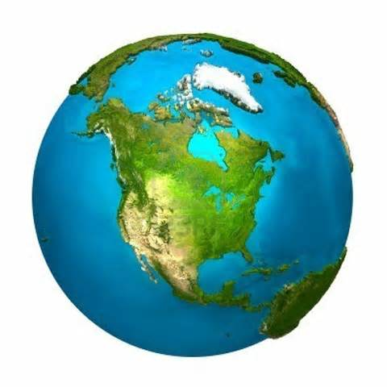
Abstraction & Data Structures
identifying the information properties of an entity relevant for a given stakeholder; each property has a value.
computer
property --> value
abstraction
property --> value
data structure
state
property --> value
algorithm
organizing the properties and their values so that they can be processed by an algorithm executed by a computer.

Slide 4
Abstracting multiple entities
Similar abstracted entities (e.g., weather reports for different locations) have the same properties but different values.
They are called instances.
properties
City | Temperature
“Blacksburg, VA” | 77
“New York, NY” | 85
“San Jose, CA” | 75
“Miami, FL” | 88
instances

Slide 5
Representing an abstraction
City | Temperature
“Blacksburg, VA” | 77
“New York, NY” | 85
“San Jose, CA” | 75
“Miami, FL” | 88
list
multiple instances,
one property
dictionary
multiple properties
one instance

Slide 6
Abstraction
An instance in an abstraction can be depicted by a table with one row
Example: an abstraction of a weather report
properties
City | Temperature
“Blacksburg, VA” | 77
values

Slide 7
Dictionary: a data structure
A dictionary is a data structure used to represent a single instance
A dictionary is organized as a collection of property-value pairs
In Python the term key-value pair is used
City | Temperature
“Blacksburg, VA” | 77
key-value pair
key-value pair
temps = { 'City' : 'Blacksburg, VA', 'Temperature' : 77}
key
value

Slide 8
Dictionary operations
temps = { 'City' :'Blacksburg, VA' , 'Temperature' : 77}
Retrieval
cityTemp = temps['Temperature']
cityName = temps['City']

Slide 9
Start classwork
Work in your cohorts on the class work problems
Notes:
READ questions/directions in the Jupyter Notebook!

