Slide 1
Introduction to Computational Thinking
Micro Project
Download data sets into BlockPy
Locate the project’s requirements and rubric
Demonstrate proficiency on multiple course objectives

Slide 2
Last Iteration Quiz
Start of class activity:
Iteration Post-Quiz 2
Post-Test BlockPy #2
Post-Test BlockPy #3
Individual, closed-notes, closed-friends, closed everything. Work on your own.
Just do your best and make an honest attempt
Complete in 25 minutes

Slide 3
Building Blocks
Seen everything except dictionaries

Slide 4
Game Plan
Abstraction
layers
list
visualize
Social Impacts
ethics
stake-
holders
model
use
blocks
text
Algorithms
nano
micro
2 weeks
5 weeks
mini
individual
8 weeks
Project

Slide 5
Learning Objectives
Explain the application of computational thinking across multiple knowledge domains.
Your project is one domain
Cohort discussion gives others
Apply the foundational principles of computational thinking to frame a question and devise a solution in a particular field of study.
asking questions and constructing algorithms to manipulate an abstraction from some specific field.
Analyze a model based on computational methods to investigate complex or large-scale phenomenon.
Uses "big data" abstraction - a model, of a large-scale phenomenon in the real-world.
Model is manipulated by your algorithms and analyzed by the interpretation of the quantitative measures and visualizations of the abstraction.
Identify the impacts of computing and information technology on humanity.
identifying the stakeholders
possible conflicts among these stakeholders..

Slide 6
Requirements
This is an individual project
Exactly six (6) slides (e.g. created in Powerpoint, Keynote, or equivalent) submitted as a single PDF file.
- Slide 1: give your name and the name of the dataset you used
- Slide 2: define abstraction and describe the abstraction that your data represents
- Slide 3: state a question, provide a quantitative measure (sum, count, average, threshold) computed by a BlockPy algorithm, and answer the question based on the quantitative measure.
- Slide 4: state a question, provide a visualization computed by a BlockPy algorithm, and answer the question based on the visualization
- Slide 5: briefly describe social impacts: who are the stakeholders? How might they be affected? What conflicts might there be among stakeholders?
- Slide 6: the statement "I have neither given nor received unauthorized assistance on this assignment." and your name. Submitting a project with this slide confirms that you have strictly observed the Honor Code rules. Projects without this slide will be rejected.

Slide 7
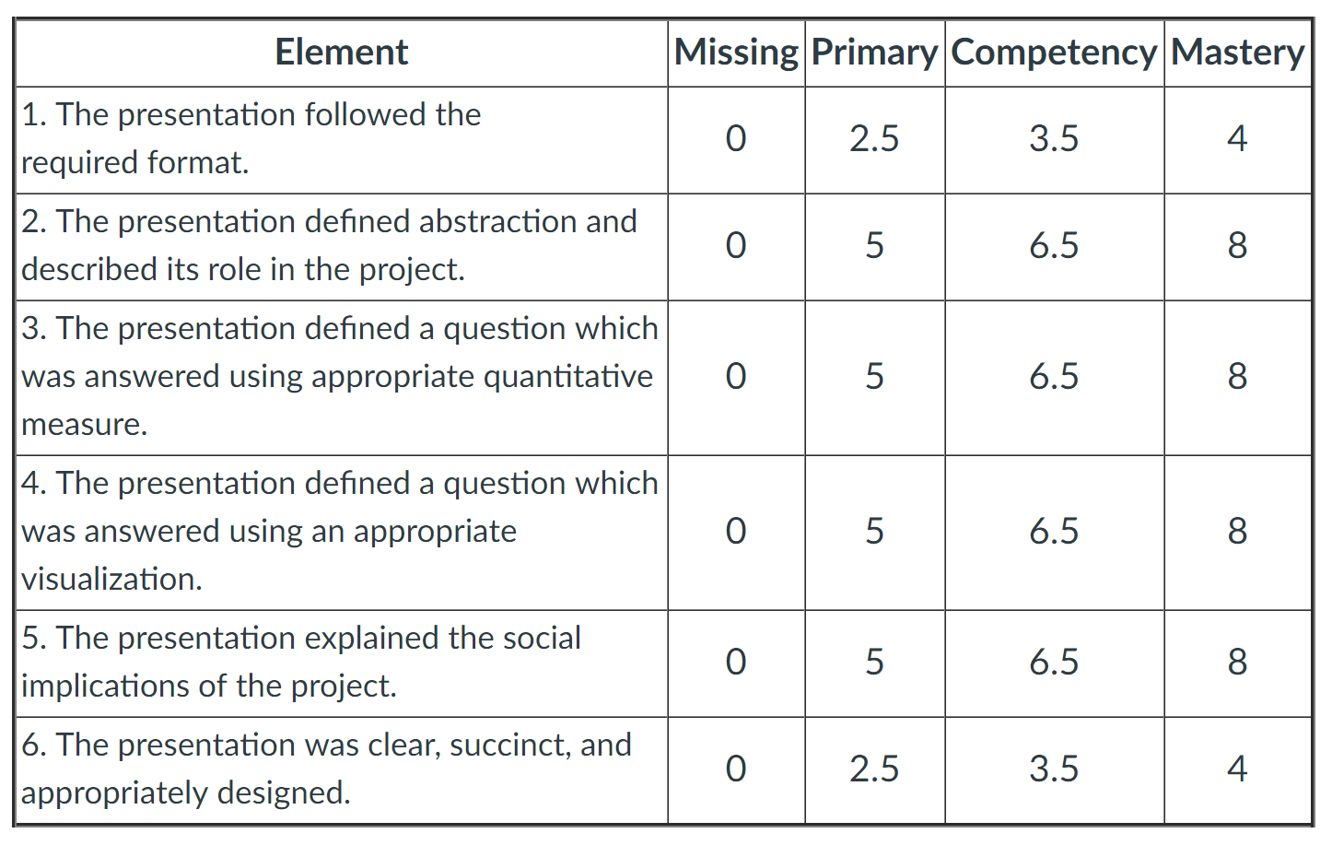
Rubric

Slide 8
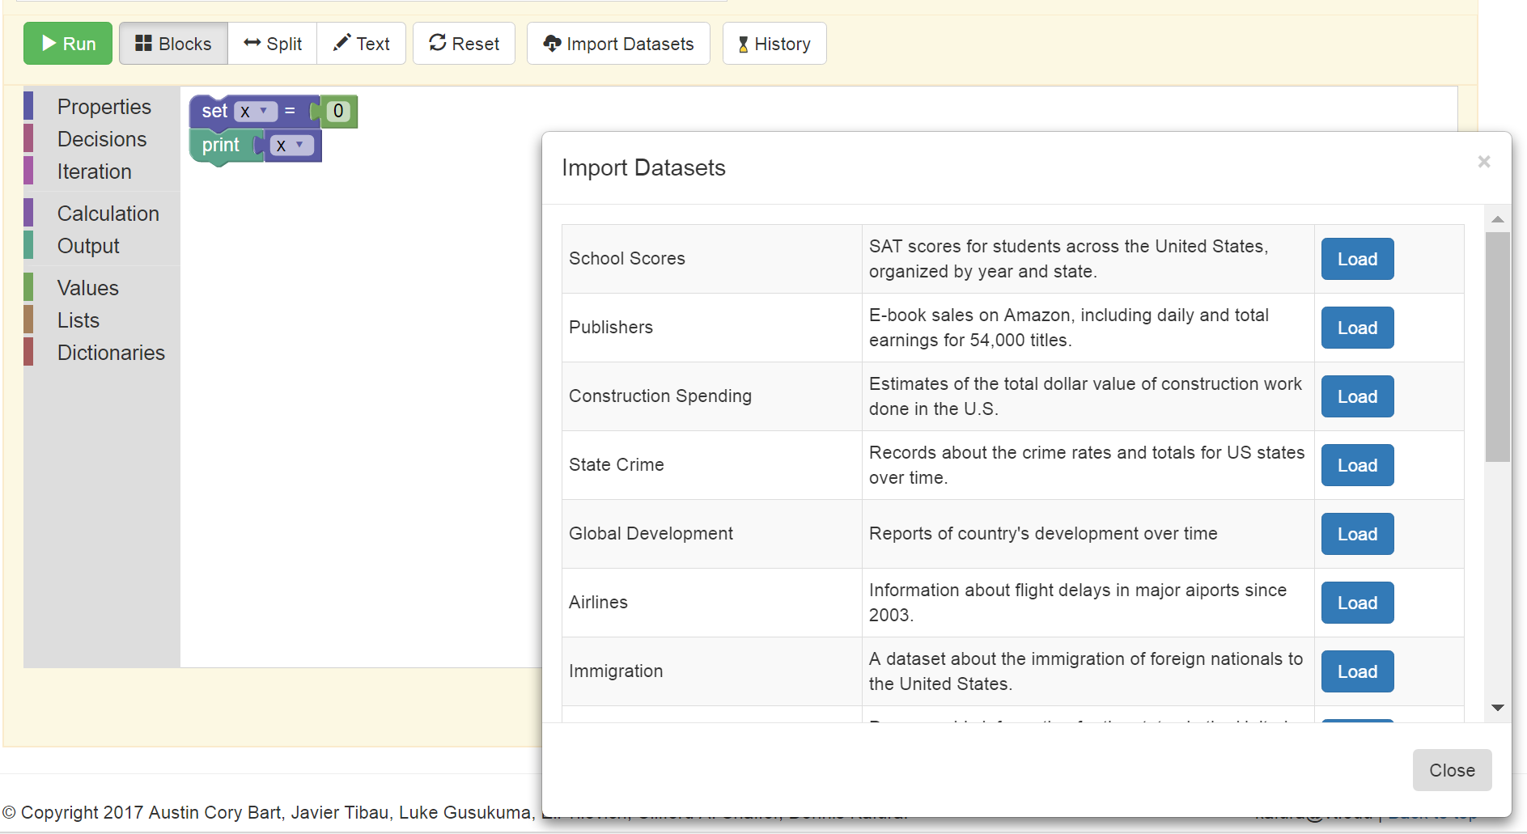
Loading Datasets into BlockPy
1
2
3
Appears here

Slide 9
Work here in class on…
Select a data set …
Micro Project – Dataset Descriptions
Classwork 12 – Choose your dataset
Code your Micro project…
Micro Project – BlockPy Canvas for Algorithm
Homework 12 – Make your Questions
Submit slides (in PDF)…
Micro Project – Slides Submission

