Slide 1
Introduction to Computational Thinking
Algorithms, Variables & State
Develop algorithms for maze problems in a block language.
Identify and explain four basic algorithmic structures.
Identify the variables used in the algorithm.
Identify a state during the performance of the algorithm.

Slide 2
Reflections
Why was writing the card algorithms difficult?
What is the difference between counting and summing algorithms?

Slide 3
Algorithms – Why Hard?
You are constructing a static description of a dynamic process
You have to mentally conceive of what the process will be
The work today will allow you to see the process
You need a good understanding of the robot/agent performing the process
Do you have a good sense of the capabilities and limitations of computers?

Slide 4
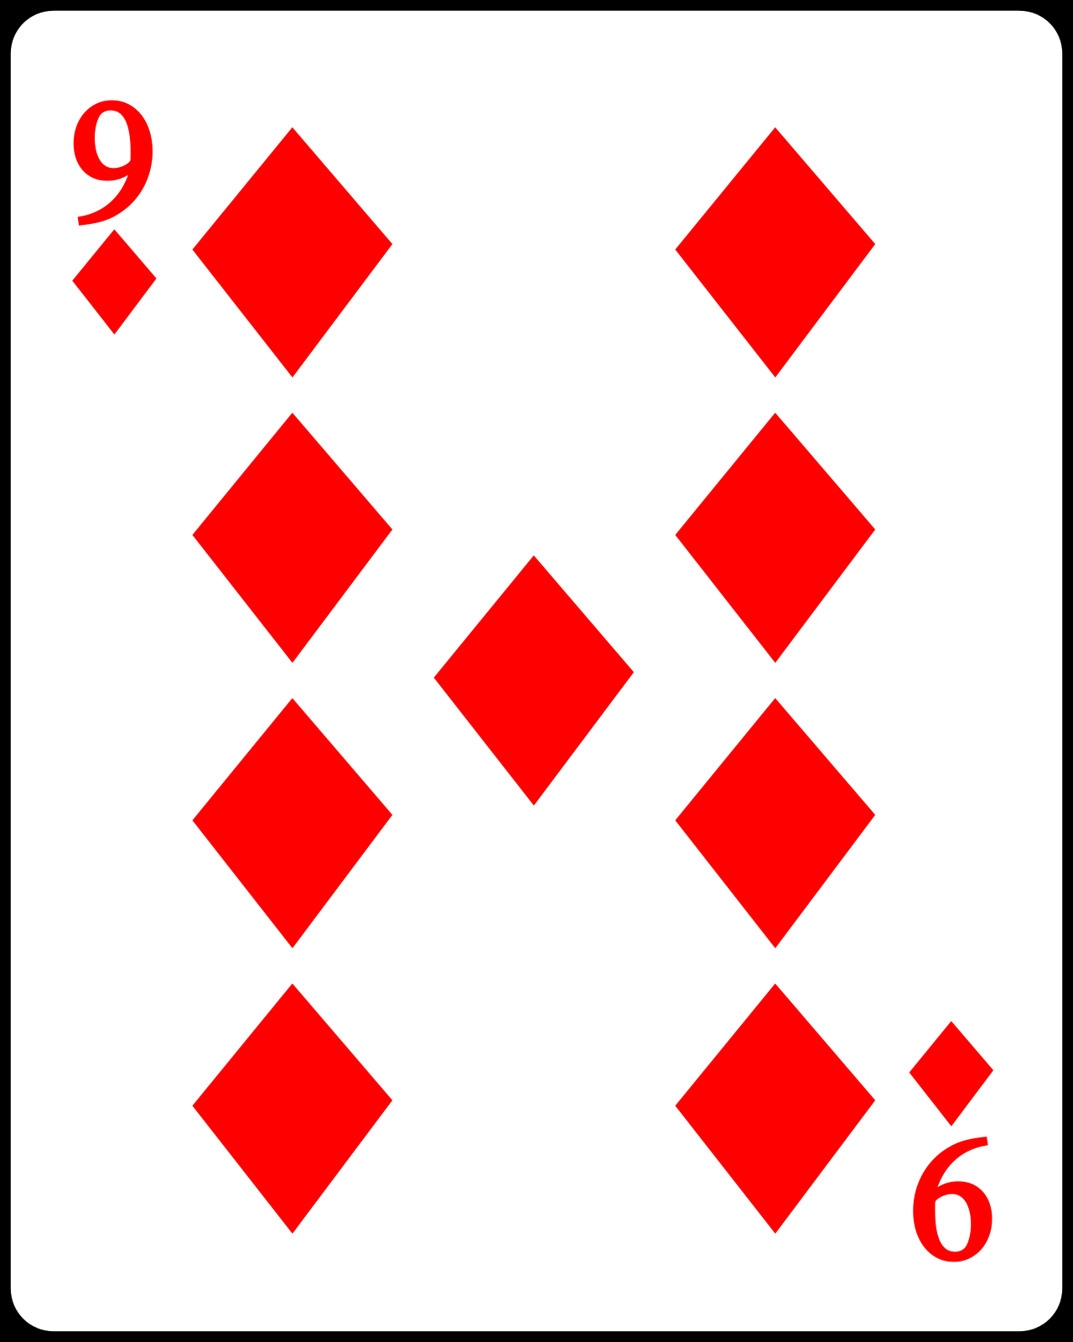
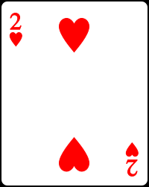
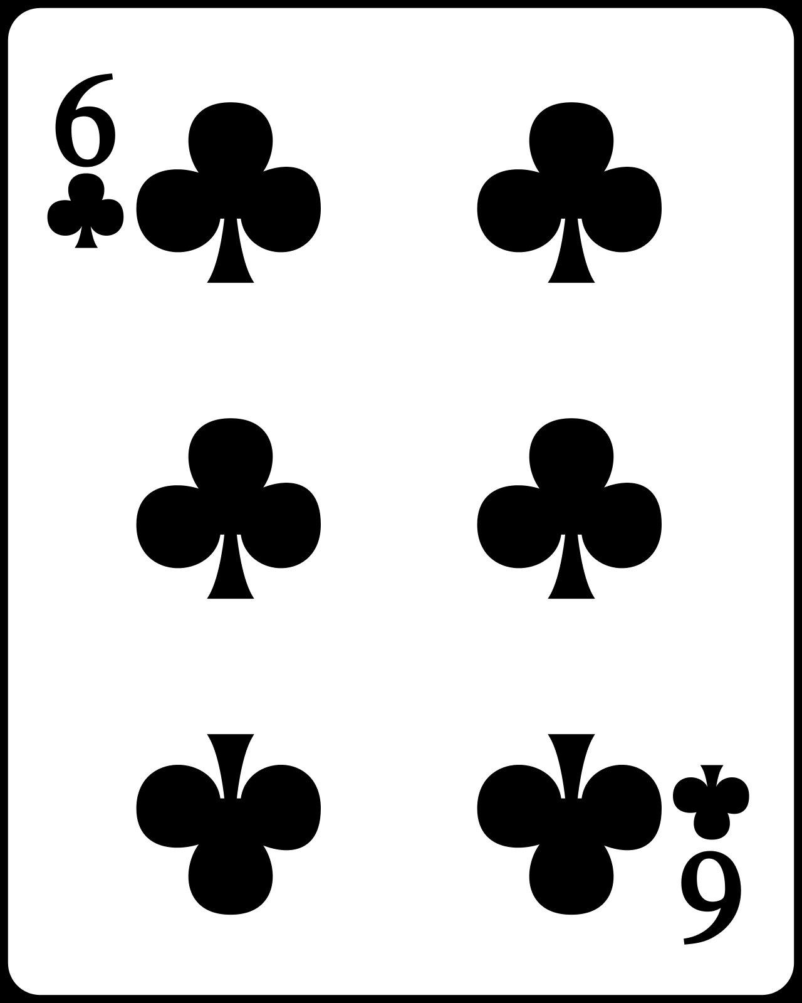
Counting vs. Summing
Value (int) | Suit (string) | Color (string)
9 | “Diamonds” | “Red”
2 | “Hearts” | “Red”
6 | “Clubs” | “Black”
Counting: the number of instances in the abstraction
Summing: the total of a given numeric property
https://commons.wikimedia.org/w/index.php?curid=1843159

Slide 5
Cohort work
Your cohort is your personal support network for the class
Today you will be doing individual work in the presence of your cohort
You are encouraged to monitor each other’s progress and help when asked.
Your job:
Provide help to your cohort members
Ask for help from your cohort members

Slide 6
Help
… is not
Here, look at my answer.
Watch me while I solve this.
Can you do this for me?
…is
Can you describe where you are stuck?
Here is the general idea, do you see how it applies to this case?
Lets simplify the problem a little and see if you can solve that one?
I don’t understand what is supposed to happen here.

Slide 7
Blockly Maze
With the cursor in the maze:
Tab : to move the maze up (to see the Run Program button fully)
Shift-Tab : to move the maze down (to see the maze selector at the top)

Slide 8
Next steps today
Work on the Maze problems in the book
Work as an individual
Seek help from and provide help to your cohort
Go as far and as fast as you can remembering to keep everyone in your cohort on board
Try to finish Maze levels 1-6
Discussion (last 15 minutes of class)

Slide 9
Block languages
Blocks in BlockPy
A visual language for constructing an algorithm
Has “blocks” for algorithm elements
Put the blocks together to form algorithms
Algorithm Elements
action : changing the value of one or more variables
sequence : doing one action after another
decision : choosing whether to take an action
iteration : repeating actions until a goal is reached
variable: information used in the algorithm
state: a record of the current values of all properties

Slide 10
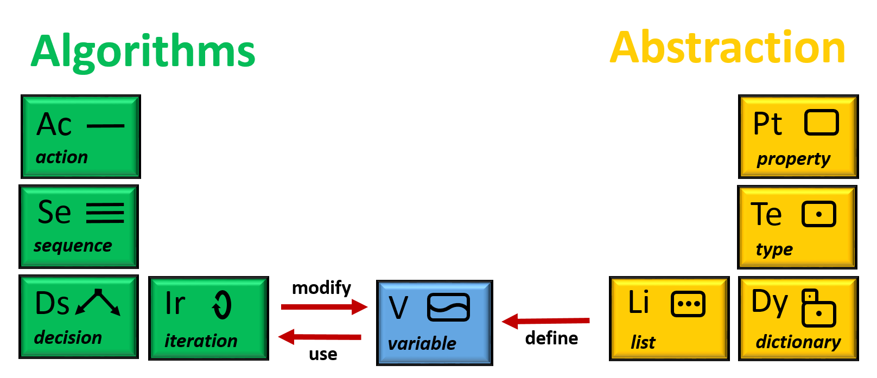
Role of Variables
(dynamic)
(static)

Slide 11
Variable
A property refers to information used in an abstraction
A variable refers to information used by an algorithm
 | Property | Variable
Has a name? | Yes | Yes
Has a value? | Yes | Yes
Has a type? | Yes | Yes
Change value? | No | Yes

Slide 12
Variables in the Maze Algorithms
The maze algorithm implicitly uses variables to denote the position of the avatar in the maze
Location (where it is in the maze: grid number)
Heading (which way it is facing: compass direction)
North
1 | 2 | 3
4 | 5 | 6
7 | 8 | 9
10 | 11 | 12
13 | 14 | 15
Variables for the Avatar
West
East
Location | Heading
South
Value of each variable

Slide 13
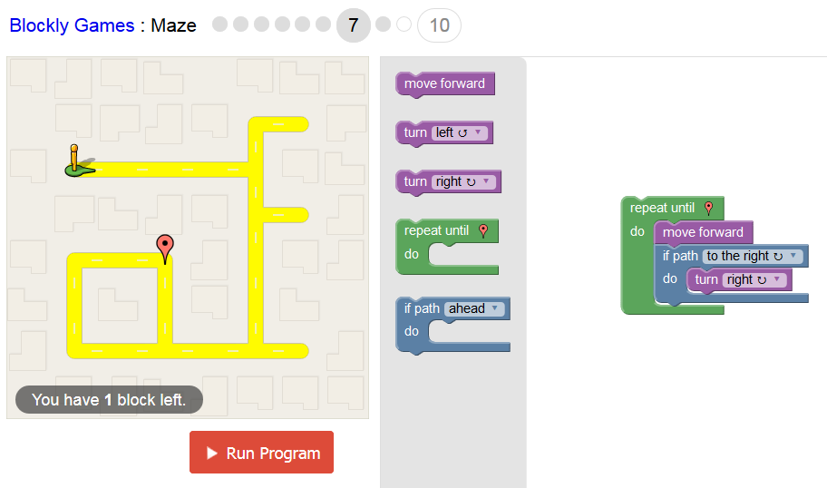
During execution -1
Location | Heading
1
East

Slide 14
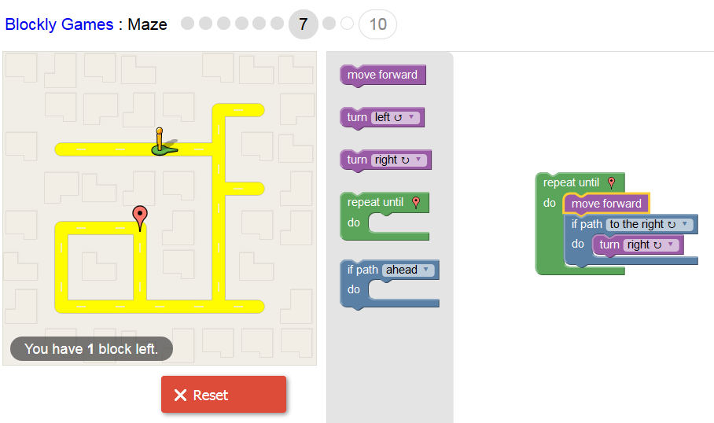
During execution -2
Location | Heading
2
East

Slide 15
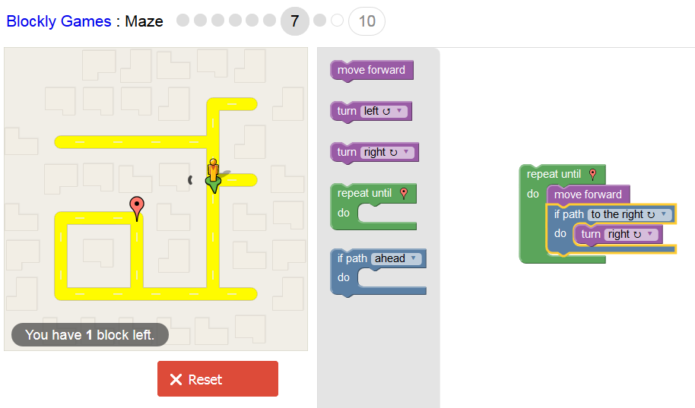
During execution -3
Location | Heading
6
South

Slide 16
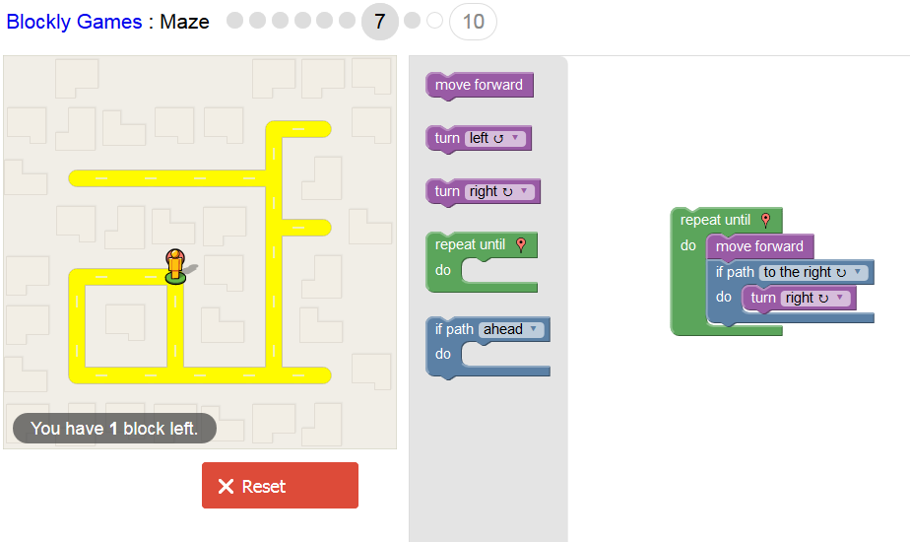
During execution -4
Location | Heading
8
North

Slide 17
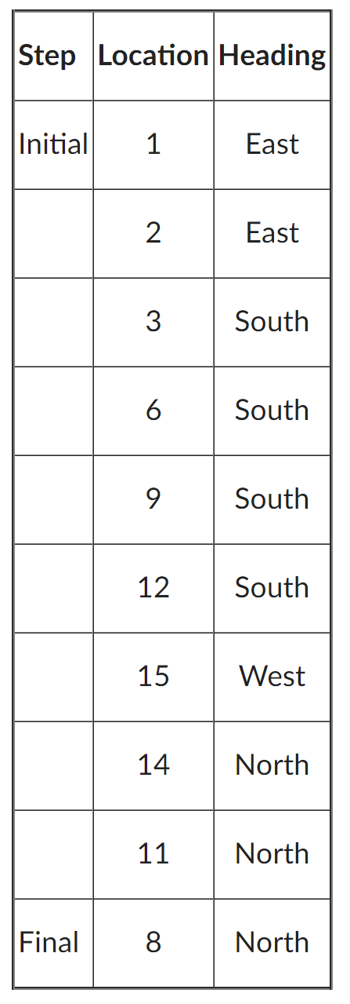
State
State
the value of all variable at a give point in the execution of the algorithm
changes as the algorithm is executed (performed)
only one state exists at a time; previous states forgotten
variables are stored in a computer’s memory
History
record of all of the sequence of states
useful in understanding and explaining the execution of an algorithm

