Slide 1
Introduction to Computational Thinking
Welcome!!
Identify course staff and contact information
Locate course materials
Define “computational thinking”
Describe course objectives and organization
Explain the course’s active learning model
State and apply the VT Honor Code
Notes:
Welcome.
This video gives a short introduction to the CT class.
After viewing this video you will be able to:
- Identify all of the course staff and know how to contact them
Locate all of the course materials
Define “computational thinking” as it is used in this class.
Describe the objectives and organization of the course
Explain the active learning model used in the class.
State the university honor code and explain how it applies in this course
Lets get started.

Slide 2
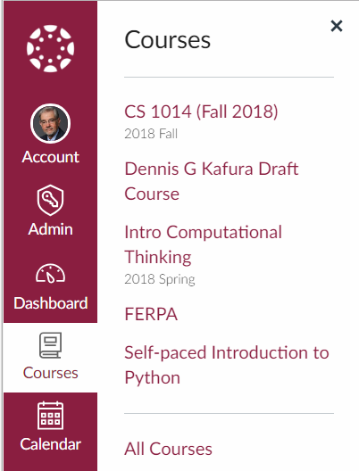
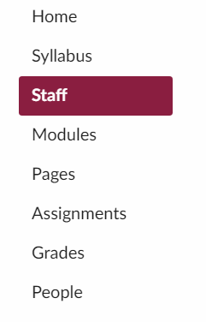
Course and Staff
Notes:
All of the course materials are on Canvas.
Logon to Canvas.vt.edu using your VT PID and click on courses to find the CS1014 course.
On the navigation menu for the course you will find an entry for Staff.
Clicking on the Staff entry shows a page with all of the pictures, names, and email address of everyone on the course staff – instructor, GTAs, and UTAs.
We will meet with everyone in each class and are happy to arrange to meet with you outside of class times.

Slide 3
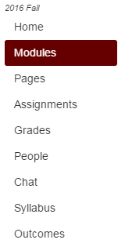
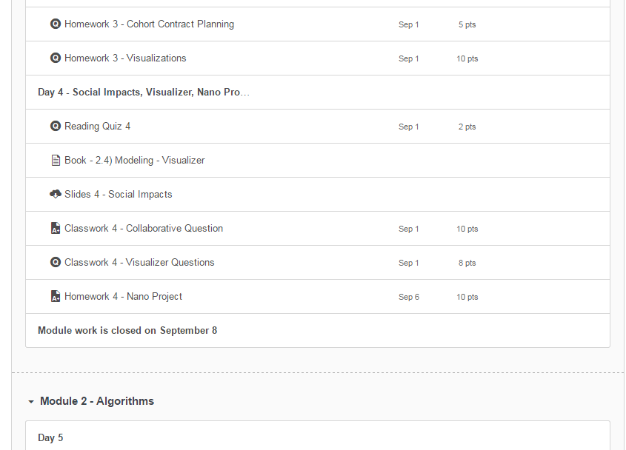
Day by day
Class Day
Slides
Class/Home work
Reading Quiz
Reading
Closing Date!!
Notes:
The Module view gives you a day-by-day list of the materials for that day. Each day has
A Reading that you should read before coming to class so that you are prepared for the active work done in class that day
A Reading quiz that should take before class. This quiz asks some short questions about the reading.
The slides used for that day’s short lecture
The class work and home work problems
It is important to note that each module has a closing date (Canvas calls this a lock date). All work for a module must be submitted before this date.

Slide 4
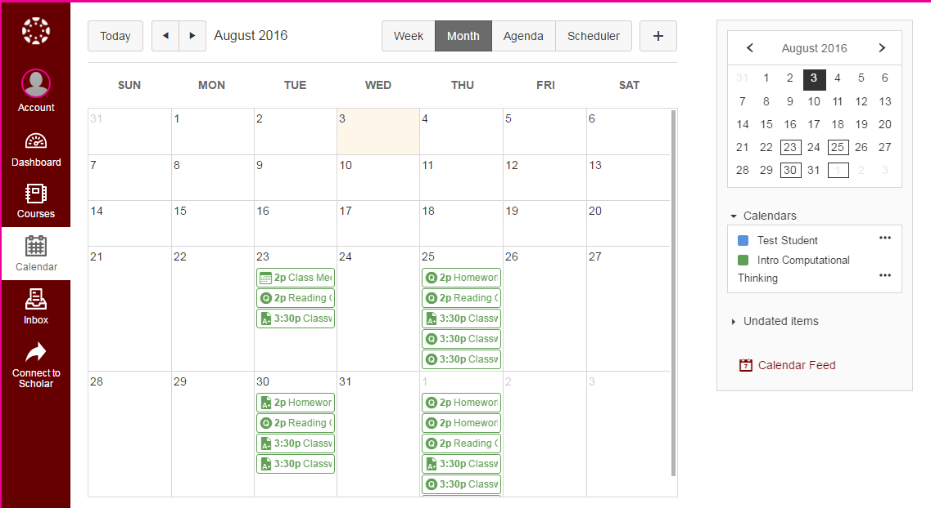
Calendar
Canvas has the readings, classwork, homework organized by due date
Notes:
In the Calendar view you will be able to see all of the dates when problems or quizzes are assigned and when they are due.
Due dates reflect when the work should be completed for optimum learning and to stay up to date with the course. Work can still be submitted past the due date up till the closing date of the module.
In general,
Reading quizzes are due at the start of the class
Classwork is due by the end of class
Homework in one class is due at the start of the next class

Slide 5
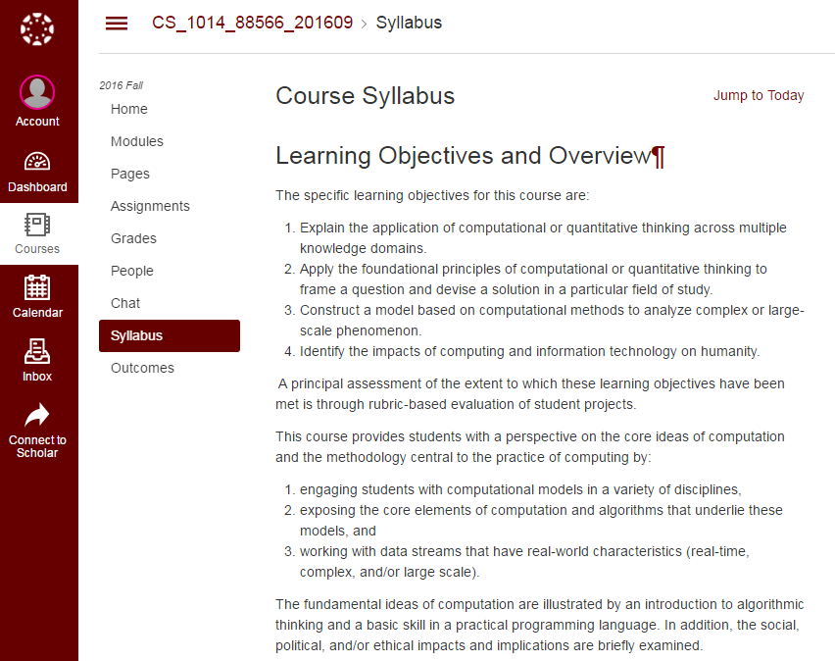
Syllabus
Read the syllabus for details
Notes:
The official syllabus for the class can be seen in the Syllabus view.
Some of the information on the syllabus will be discussed in this introduction, but you should read the syllabus as it represents the “contract” for the course and gives more detail than will be discussed in this introduction.

Slide 6
Lets Get Started
Take Reading Quiz 1
Reading Quizzes
This first “reading” quiz ask for some initial thoughts on the class
Future quizzes will ask questions about the assigned reading for the day.
Notes:
In the actual class students would be taking the first Reading Quiz.
If you did not take this quiz in class you should do so now.
Since you were not excepted to have done any reading before this first class, the first reading quiz asks some general questions about how computation is used in your major field of study.
Keep in mind that future Reading Quizzes are about the assigned reading for each day.

Slide 7
First class work
At your table discuss and answer together the questions distributed on paper. Nominate someone at your table to report for your table.
Report back in 20 minutes.
Notes:
At this point in the first class students were asked to discuss with others at their table three questions that asked about
What you think is meant by the term computational thinking
Why you are taking this class
And your experience with having learned something new and different in the past.
If you were not in class you should download the PDF form of these questions from Classwork 1, complete your answers, and give them to one of the course staff.

Slide 8
What is Computational Thinking?
Computational Thinking = abstraction + algorithms
Representing a thing by its information properties.
Manipulating the properties of things by a precise set of rules.
Notes:
Computational thinking as used in this class is the combination of two powerful ideas:
Abstraction which is the ability to represent or model entities in the real world by a collection of information properties that describe relevant aspects of that entity
In this class big datasets containing abstractions of real world thing from earthquakes to crime will be used
An algorithm is a precisely defined process by which a computer is instructed on how to manipulate an abstraction.
In this class the algorithm will manipulate the big datasets to answer questions about the real world

Slide 9
Big Picture
abstraction
social
impact
algorithm
Notes:
The technical ideas of abstraction and algorithms give us the ability to model the real world and explore that world computationally.
But we will also study how these technical abilities have impact on society – affecting the lives of real people, in some cases in a positive way and in other cases in a negative way.
In completing your projects in the class you will be asked to consider the social impacts of your project.

Slide 10
Learning Objectives
Explain the application of computational thinking across multiple knowledge domains.
Apply the foundational principles of computational thinking to frame a question and devise a solution in a particular field of study.
Construct a model based on computational methods to analyze complex or large-scale phenomenon.
Identify the impacts of computing and information technology on humanity.
The principal means of assessing attainment of these learning objectives are the four projects, especially the three week final course project.
Notes:
This class has four high level learning objectives:
The first objectives relates to the idea that computation can be useful in any field of study. We will see this
By working with abstractions and data from a variety of real world entities and
by interacting with other students from a variety of majors
The second objective relates to using computational thinking to ask and answer a question
We will do this by developing algorithms that help us to answer questions
The third objectives relates to using computation to deal with complex real-world phenomenon.
We will do this by learning how complex data descriptions are organized and learning how to write algorithms for such data
The fourth objective relates to how computing has impact on society.
We will do this by learning a model of how computing has social impacts and
Learning how to apply this model and ethical theories to specific cases
The four projects in the class are an important way for you to demonstrate your achievement of these learning objectives.

Slide 11
Game Plan
Abstraction
layers
list
visualize
Social Impacts
ethics
stake-
holders
model
use
blocks
text
Algorithms
nano
micro
2 weeks
5 weeks
mini
individual
8 weeks
Project
Notes:
Here is how the course is organized.
The four major activities in the course are
algorithms and abstraction, the two technical idea underlying computational thinking,
Social impacts – how computing affects real people
And the four course projects
We will progress through the course in a serial of spirals – on each spiral we will learn more about algorithms, abstraction, and social impacts and do more on the projects.
The first cycle is completed in the first two weeks. In this cycle we will use already prepared algorithms to visualize information that helps us to answer a question and begin using the model of social impacts. The first cycle ends with a short, quick project called the nano project – the name suggesting that is is small.
The second cycle takes the next 5 weeks to complete. In this cycle we will develop algorithms in a safe and supportive block language. These algorithms will process long lists of data to compute properties about the data. So called stakeholders – those affected by computing will be identified. This cycle ends with a project lasting several days. This project is called the micro project.
The third and last cycle is one where a popular text programming language (Python) is used to manipulate highly complex data. Ethical principles will be explored to make judgements about the social impacts. This cycle, with takes 8 weeks to complete, end with two back-to-back projects:
A “mini project done with some degree of collaboration among teams of students
An individual final project. This is a major activity where you can demonstrate your ability to bring to bear all of the knowledge and skills that you have developed in the class. About three weeks of class time is devoted to this project.

Slide 12
Building Blocks
Learn incrementally – create anything!
Notes:
Another way to view the organization of the course is through the more detailed components that make up the ideas of abstraction and algorithms that are shown in the table of computational elements.
We will learn these building blocks of computation – starting with a few building blocks and adding more as we go.
While there are only a few building blocks, these are enough to write any algorithm! More complex algorithms and abstractions can be created simply by putting these building blocks together in more complex ways. Just as with Legos or mosaics – you can create large and complicated constructions with only a few basic shapes.

Slide 13
Grading
Assignment | Percent | Evaluation
In-class work and homework | 50% | This work is evaluated by course staff or automated checking.
Projects | 30% | There are four projects evaluated by a rubric assessing the quality and completeness of the project.
Attendance | 10% | This work is evaluated by recorded attendance.
Reading Quizzes | 10% | This work is evaluated by demonstrated understanding of the required readings.
Check regularly and raise questions in a timely (i.e., within two week) manner questions or concerns about assignment grading
In submitting the final project you accept responsibility for having reviewed and accepted the scores on all assignments except for the final project itself.
Notes:
A final way to view how the course is organized is in terms of the grading scheme.
As you can see
the classwork and homework are half of the final grade.
The four projects combined are 30%, and
The attendance and reading quizzes are each weighted at 10%

Slide 14
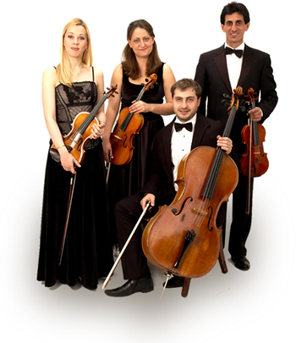
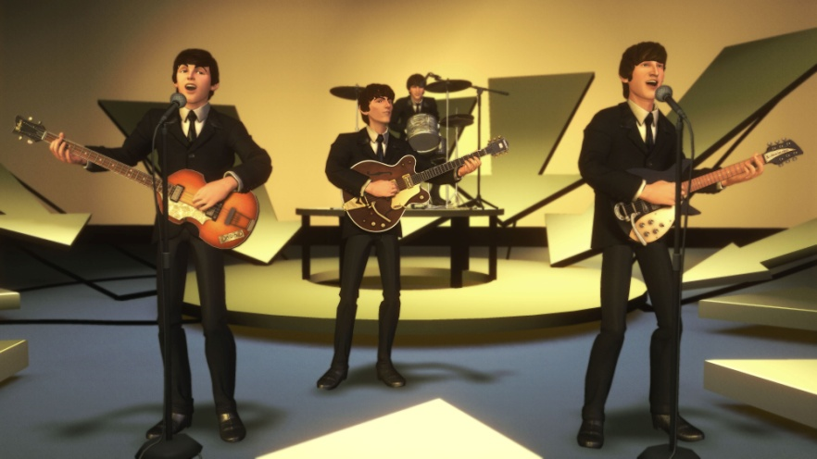
Active Learning
Work effectively together in your cohort
Your cohort is a peer learning group
In-class work
Specific assignments
General support
Cohort contract
Notes:
As you will quickly see most of our time in class will be spent in working on problems – building and analyzing abstractions, writing algorithms, and interacting with other students in the class.
As you will se in class, everyone is seated at a four person table. These four person groups are called “cohorts”. On the third class day you will be assigned into a cohort that you will keep throughout the semester. The cohorts are organized to have four different majors in each cohort – allowing diverse perspectives to be brought to bear in your learning.
The cohort is a peer learning group – you are strongly encouraged to help each other master the concepts and skills in the class by interacting to help each other: asking questions about the problems, giving help when another cohort member is stuck, offering encouragement to continue, congratulating them on their success.
Shortly after the cohorts are formed we will have you write a cohort contract stating the obligations that each member in your cohort has to themselves and to the others in the group.
The cohort is the at the center of the learning in this class – the UTAs, GTA and instructors are here to help support this learning.

Slide 15
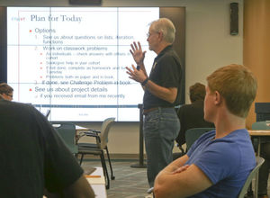
What it takes to succeed
Be conscientious and consistent in
Do the Reading and take the Reading Quiz before each class!
Attend class to engage in active learning. We will keep attendance.
Don’t fall behind - meet due dates.
Complete assigned work before close of each module.
Notes:
What does it take to succeed in this active learning environment and to be a good cohort member?
- First, be prepared for each class: complete the reading and the reading quiz before class
- Second, come to class – be there to interact with your cohort and to get help from them and the course staff
- Third, keep up with your cohort and the class by meeting the due dates
- Lastly, be sure to complete all the work on a module before the module closes.

Slide 16
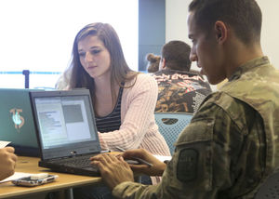
Everyone can succeed
Each critical concept is seen three times in different contexts – you just need to get it once.
Make a good faith effort to do all course work and you will get a passing grade.
Others from many majors have succeeded – so can you!
Support from your cohort and UTAs
Final project
You propose
Three weeks to work on
Notes:
Fortunately, the class is designed to help everyone succeed!
All of the critical concepts are seen on each of the three cycles: you just need to get it once
Make a good faith effort to do all the course work and you will get a passing grade
Others from you major have succeed before – so can you
You are not alone: your cohort members, the UTAs and all the staff are here to help
Looking ahead: the final project is largely your to define and about three weeks of class time is devoted to this activity.

Slide 17
Honor Code
All work in the class is done under the rules of the university honor code.
Notes:
The Virginia Tech honor code statement is a pledge to maintain personal integrity in our academic pursuits and to expect similar integrity from everyone else.
This standard of conduct applies to all the work in this class.
If you observe violations of the Honor Code in this class you should report this to the course instructor.

Slide 18
Honor Code in this class
In general:
you are encouraged to seek assistance in learning the course concepts and tools, but
providing or accepting significant parts of answers is NOT allowed as this does not reflect learning.
Specifically:
All classwork, homework, and the Mini project (third project) is intended to be collaborative within your cohort.
The projects (except the mini project noted above) should represent your own work.
The code (in BlockPy or Python) you submit for classwork, homework, and projects should represent code that you personally wrote, understand, and can explain.
See Syllabus for complete statement.
If in doubt – ASK!
Notes:
But how does the Honor Code apply in active learning class where collaboration within our cohort is strongly encouraged?
The general guidance is that this class is all about the learning: you are encouraged to collaborate with your cohort and seek help from the UTA and other staff but simply providing or accepting significant parts of answer is not allowed because this does not represent real learning – it is avoiding the learning.
More specifically,
- Your work on the classwork, homework, and Mini project is intended to be highly collaborative within the guideline just given about the central role of learning.
- The projects should clearly represent you own work and be a clear expression of your understanding.
The algorithms that we write (in either of the two languages we will use) should be something that you wrote, understand and can explain.
See the syllabus for details and if ever in doubt – ASK the course instructor.

Slide 19
Class is a research project
This is a new class in the Quantitative and Computational Thinking general education requirements (also satisfies old Area 5)
We study the class as part of the scholarship of computing education research
To improve the class and to demonstrate the innovations at Virginia Tech
We ask your consent to allow us to use data and observations about the class as part of our study
Consent is voluntary and in no way affects your participation in the class or your grade
Soon we will have a form for you to sign
Notes:
There are many level of learning in this class – and it is a place where we as instructors are also learning.
As part of our endeavors in the research of computer science education we use this class as a laboratory to use and assess innovative educational practices. We have written research papers based on our experience and have funding from the National Science Foundation to support this research.
We will be ask you to give your consent to allow us to use the data we collect in the class as part of this research with the understanding that none of the reported research will allow you to be identified.
Though we would appreciate your consent, this is purely voluntary and has no influence on our grade or your participation in the class.

Slide 20
Prepare for next class
Do homework and reading
Take Reading Quiz 2 before the next class
Notes:
Well, that’s it for the start.
The next step is to get ready for the next class meeting
- The homework today, and
- Do the reading and the reading quiz before our next meeting.

