Slide 1
Introduction to Computational Thinking
Creating
Visualizations
Create algorithms that generate a new list.
Create algorithms that transform data.
Create algorithms that generate visualizations.
Create algorithms that generate visualizations of filtered data.

Slide 2
Class Activity
Starting promptly at beginning of class.
Ends promptly after 30 minutes.
Closed notes, no talking
Start of Class Activity
Iteration Post-quiz 1
Post-test BlockPy #1
DO BOTH IN 30 MINUTES!
Don't worry about getting a perfect score, just do your best.

Slide 3
Transformed Data
Motivation: generate a “transformation” of the abstraction being processed
Create a list of forecast temperatures in Celsius from a list of temperatures in Fahrenheit.
Create a list of “feels like” temperatures from a list of weather forecasts that give temperature and wind speed.
Create a list that categorizes each state’s crime rate as high, medium, or low from a list of crime rates by state.
10
7
15
2
9
14
4
How do we go from this…
…to this (doubling each element)?
20
14
30
4
18
28
8

Slide 4
Transformed Data
iteration
Existing List
A
Transform: A -> B
New List
B
append

Slide 5
Creating a new list
Two new operations
create an empty list
append (“add”) a new item to end of a list
Before Iteration
During Iteration
*Vocab: “append” means “add to end”

Slide 6
Transform in action
List Variable representing an Abstraction
Variable representing a New List
Iteration
Put transformed values into new_ list Variable
*Vocab: “append” means “add to end”

Slide 7
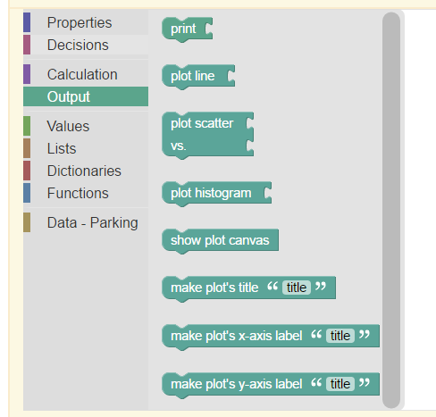
Plotting
Making lists means making plots!
A list of numbers (over time)
Two equal-sized lists of numbers
Any list of numbers
Actually draw the plot
Give titles and labels

Slide 8
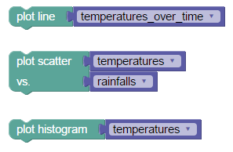
Plot, then Show
After you plot…
YOU MUST SHOW

Slide 9
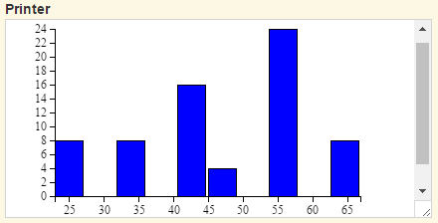
Print vs Plotting
Printing is for Quantitative Measures
Plotting is for lists

Slide 10
Visualizations of Filtered Data
Motivation: in big data only certain occurrences may be of interest
Big earthquakes
Temperatures above or below a certain threshold
A high or low crime rate
Mechanism: combine
iteration – to provide each element one at a time
decision – use each element that passes the filter test and ignore others

Slide 11
Selective variation
iteration
Existing List
A
If filter test for A is
true
false
New List
A
append

Slide 12
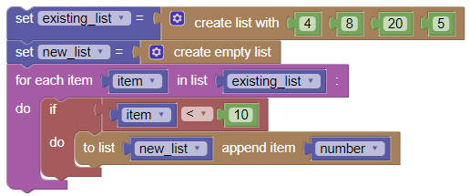
Selective Variation in BlockPy
Iteration
Decision
Append

Slide 13
Next steps today
Work on the assigned BlockPy and list problems using iteration and decision
Work as an individual
Seek help from and provide help to your cohort
Go as far and fast as you can, keeping everyone in your cohort on board
Cohort feedback/reports

