Slide 1
Introduction to Computational Thinking
Social Impacts
Ethical Reasoning
discuss several ethical situations
examine three ethical frameworks
apply ethical frameworks to a case study

Slide 2
Measuring Progress
Take 25-30 minutes to complete
Day 19 Dictionary Post-Quiz 2
Day 19 Dictionary Post-Quiz Programming
There are two Jupyter Notebooks
Upload both to Canvas even if not completed
Things to know:
Part of the course research/improvement
Do your best effort; will not affect your grade

Slide 3
Game Plan
Abstraction
layers
list
visualize
Social Impacts
ethics
stake-
holders
model
use
blocks
text
Algorithms
nano
micro
2 weeks
5 weeks
mini
individual
8 weeks
Project

Slide 4
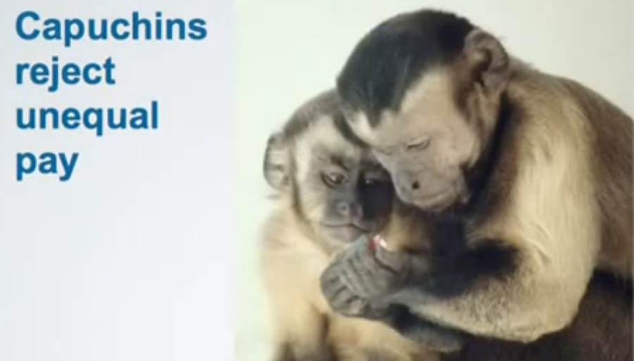
Fairness
https://www.youtube.com/watch?v=lKhAd0Tyny0

Slide 5
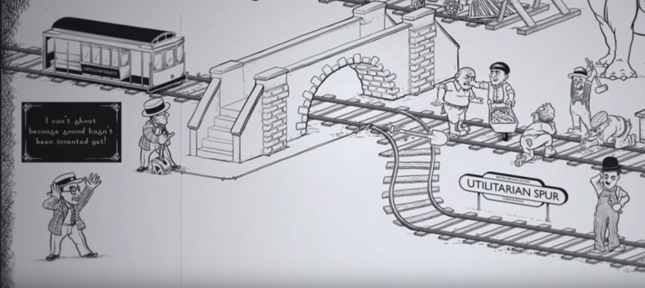
The Trolley Car Problem
Part 1
https://www.youtube.com/watch?v=bOpf6KcWYyw

Slide 6
Discussion
What would you do?
Why ?

Slide 7
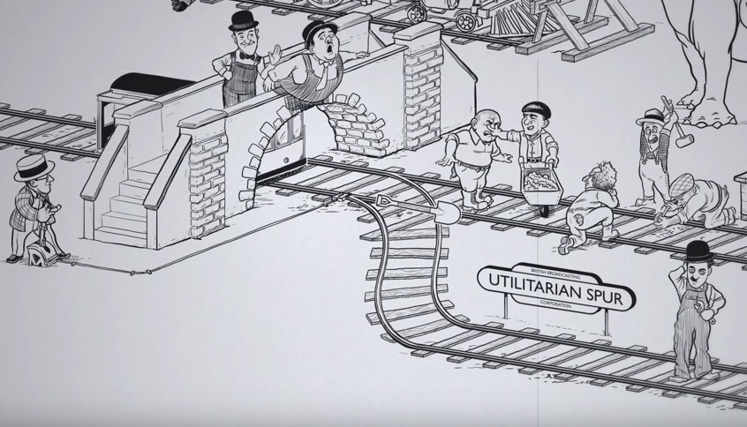
The Trolley Car Problem
Part 2
https://www.youtube.com/watch?v=bOpf6KcWYyw

Slide 8
Discussion
What would you do?
Why ?

Slide 9
Ethics
Not lists of rules to be memorized…
.. but a personal guide to responsible professional behavior towards stakeholders in the face of conflicting needs and rights.
Stakeholders: those in society affected, positively or negatively, by the use of power.

Slide 10
Two sides of the (bit)coin
You may affect stakeholders by the exercise of power through your professional knowledge whether involving computation or not
A grounding in ethics helps you behave professionally in a way that you can live with
You are a stakeholder because others certainly exercise power over you through their knowledge of computation
A grounding in ethics is important to knowing and acting upon your rights as a member of a free technological society.

Slide 11
Ethics
Ethics: “systematizing, defending, and recommending concepts of right and wrong behavior” Internet Encyclopedia of Philosophy
Normative ethics: “moral standards that regulate right and wrong conduct”
An ethical issue: when the actions of one party pursuing their goal affects the ability of another party to pursue its goal
Elements of an ethical situation:
The moral agents (those bringing about the technology-induced change)
Alternative courses of action that the moral agent can take
The effects of each course of action
The stakeholders impacted by these effects

Slide 12
Ethical frameworks
Consequence
an action is morally right if the consequences of that action are more favorable than unfavorable
Duty
acting to fulfill a fundamental obligation to ourselves or others
treating a person as an end and never a means to an end (Kant)
rights : a justified claim on another’s behavior
justice: the duty to recognize merit
Virtue
acting in ways that foster good habits of character (courage, generosity, sincerity,...)

Slide 13
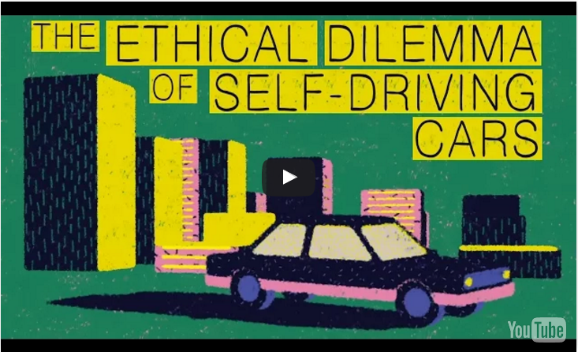
The Autonomous Trolley Car
https://youtu.be/ixIoDYVfKA0
http://ed.ted.com/lessons/the-ethical-dilemma-of-self-driving-cars-patrick-lin#watch

Slide 14
Discussion
Discuss in your cohort the answers to the class work questions.
Report back for class discussion

