Slide 1
Introduction to Computational Thinking
Abstraction
Define abstraction
State the characteristics of a property
Name the four basic types
Identify the parts of an abstraction
Construct a table representing an abstraction

Slide 2
Elements
Representing the real world

Slide 3
Learning Objectives
Explain the application of computational or quantitative thinking across multiple knowledge domains.
Apply the foundational principles of computational or quantitative thinking to frame a question and devise a solution in a particular field of study.
Construct a model based on computational methods to analyze complex or large-scale phenomenon.
Identify the impacts of computing and information technology on humanity.
Abstraction forms a model of things in the real world.

Slide 4
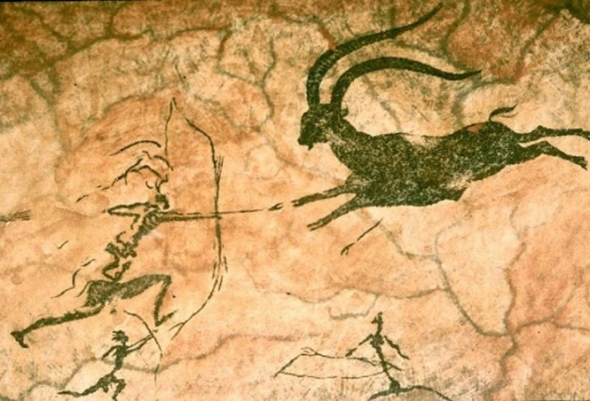
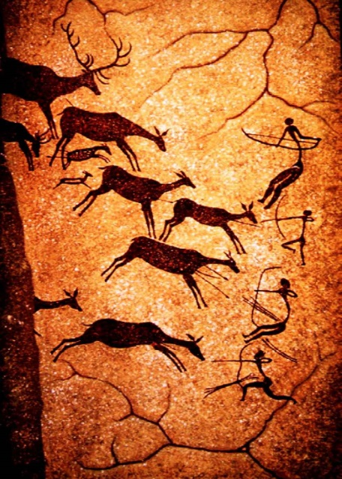
Abstraction
Humans have always used abstraction to model and understand the world
With computers we can form abstractions using a new medium – information.
Information abstraction is one of the two “big concepts” of computational thinking
Information abstractions can be manipulated via algorithms (the second “big concept” of computational thinking)

Slide 5
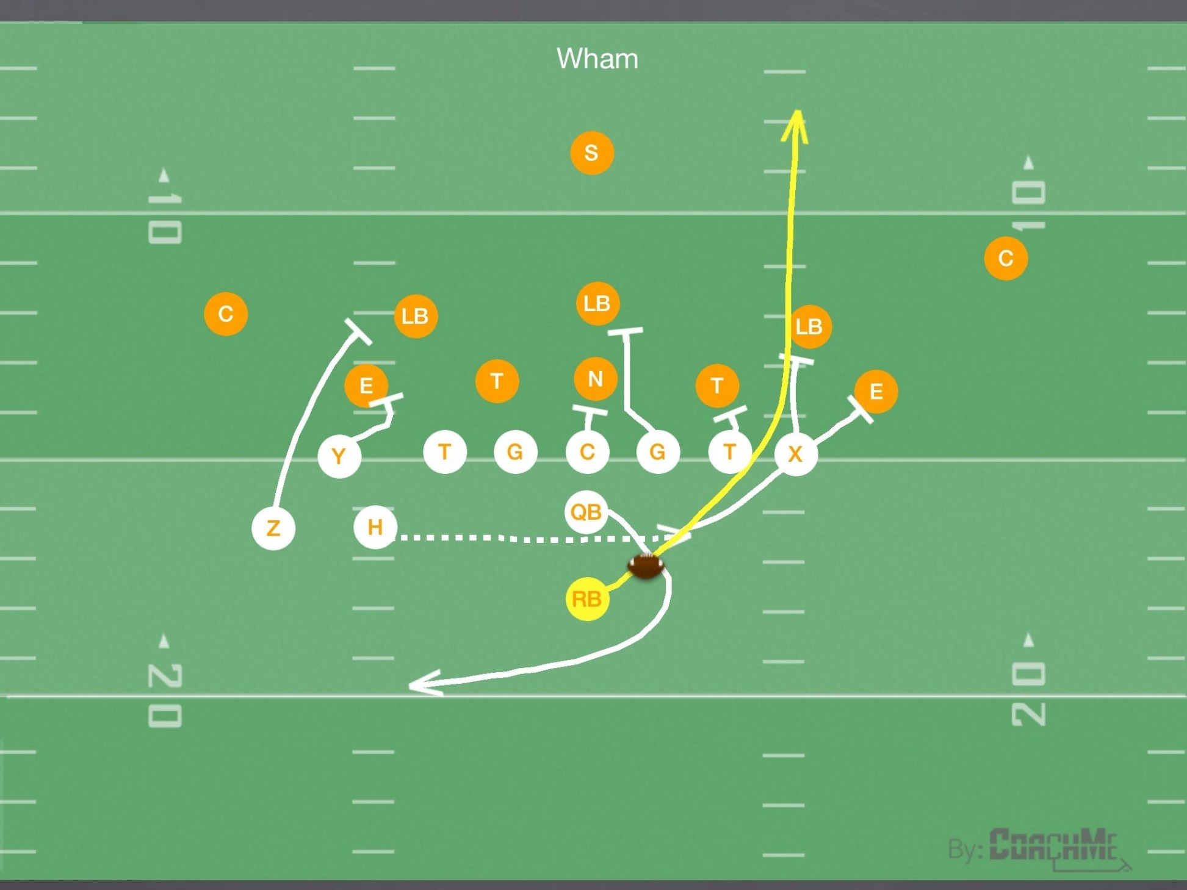
Abstractions – then and now

Slide 6
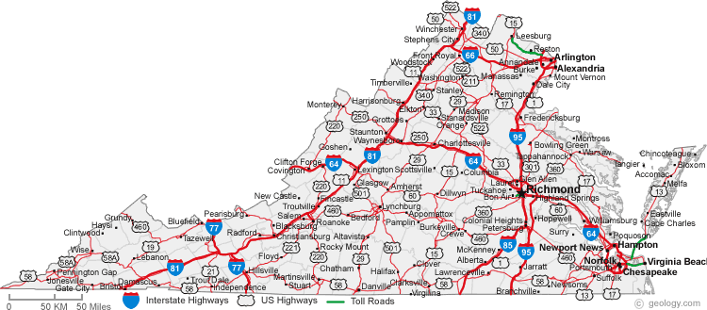
Familiar abstractions
What is this an abstraction of?
For whom (aka. stakeholder) is it designed?
What are its properties?

Slide 7
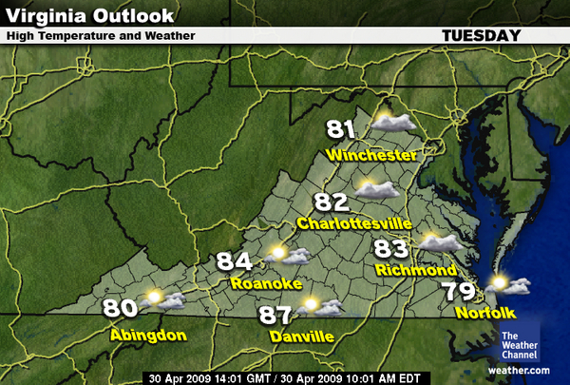
Alternative view…
What is this an abstraction of?
Who is the stakeholder?
What are its properties?

Slide 8
Information Abstraction
Maps are physical abstractions of physical things
We can also form information abstractions of physical things
An information abstraction is
A set of properties relevant to a specific stakeholder
Each property
Is named
Is objective
Recorded in quantitative terms (numbers, characters, codes, categories)

Slide 9
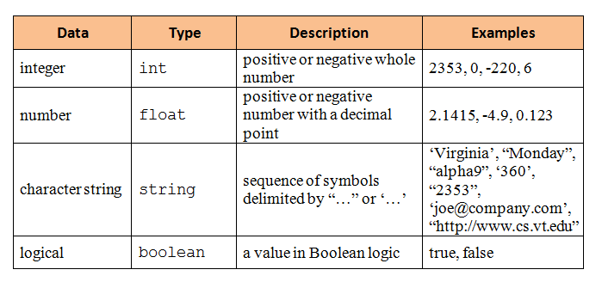
Types
The value of a property must be of a known “type”
Computers are built to work with these types

Slide 10
What’s in a type?
People and computers see types very differently
Type conversions exist
String to int
String to float
Type | People | Computers
int | 1000 | 000003E8
string | “1000” | 31303030
float | 1000.0 | 447A0000

Slide 11
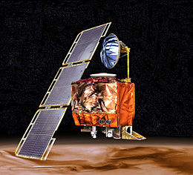
Units
Types do not have units (yards, years, pounds, acres, dollars, etc.)
The programmer and user must communicate the units outside of the program
This can be problematic
Mars Climate Orbiter
Crashed into Mars
September 23, 1999
due to a units conflict
In the use of the software

Slide 12
Representing Abstractions
name
stakeholder
description
Movie On-Line Customer
Title (string) |  |  | Genre (string)
“Gone With the Wind” |  |  | “Drama”
property
type
instances
values

Slide 13
Example
Abstraction of a “movie” for an on-line customer stakeholder.
Movie On-Line Customer
Title (string) | Year (int) | Length (int) | Genre (string) | Format (string) | Price (float)
“Moneyball” | 2011 | 133 | “Sports” | “Blueray” | 15.00
“Gone With the Wind” | 1939 | 219 | “Drama” | “DVD” | 10.95
“Jurassic Park” | 1993 | 127 | “SciFi” | “DVD” | 12.50
“Pirates of the Caribbean” | 2003 | 143 | “Comedy” | “Blueray” | 17.50
“Sicko” | 2007 | 116 | “Documentary” | “Streaming” | 11.75
The abstraction has six (6) properties (columns).
There are five (5) instances (row)

Slide 14
Correspondence
Each instance corresponds to a single real-world entity.
Movie On-Line Customer
Title (string) | Year (int) | Length (int) | Genre (string) | Format (string) | Price (float)
“Moneyball” | 2011 | 133 | “Sports” | “Blueray” | 15.00
“Gone With the Wind” | 1939 | 219 | “Drama” | “DVD” | 10.95
“Jurassic Park” | 1993 | 127 | “SciFi” | “DVD” | 12.50
“Pirates of the Caribbean” | 2003 | 143 | “Comedy” | “Blueray” | 17.50
“Sicko” | 2007 | 116 | “Documentary” | “Streaming” | 11.75

Slide 15
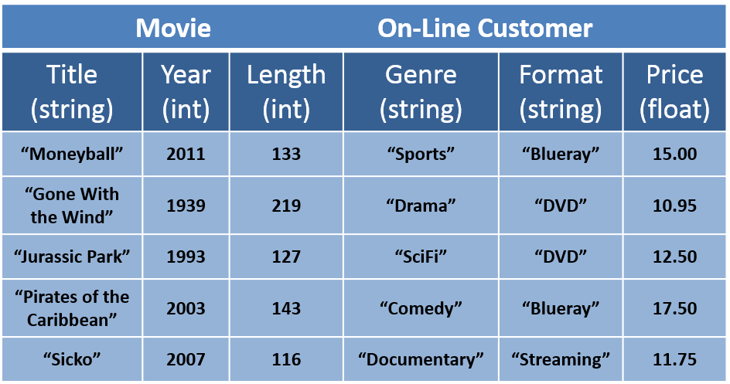
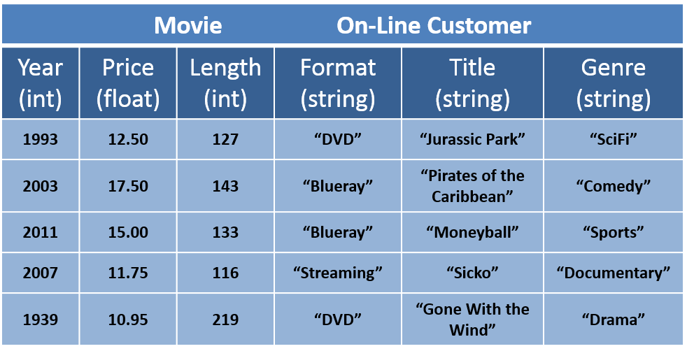
Different representations
Are these the same?

Slide 16
Cohort work and Reports
Complete the representation of the abstractions distributed at your table.
Report back in 20 minutes.
Class discussion.

Slide 17
Other slides
Use as needed

Slide 18
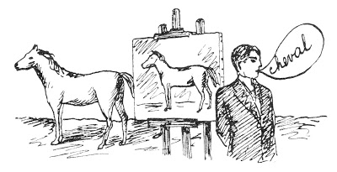
Magritte and abstraction
The Treachery of Images
“An object never serves the same purpose as its name or its image.”
Rene Magritte

Slide 19
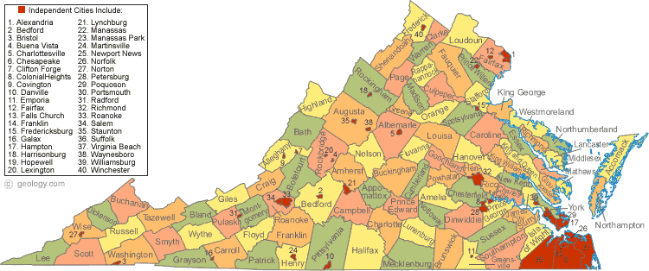
Alternative view
What is this an abstraction of?
Who is the stakeholder?
What are its properties?

Slide 20
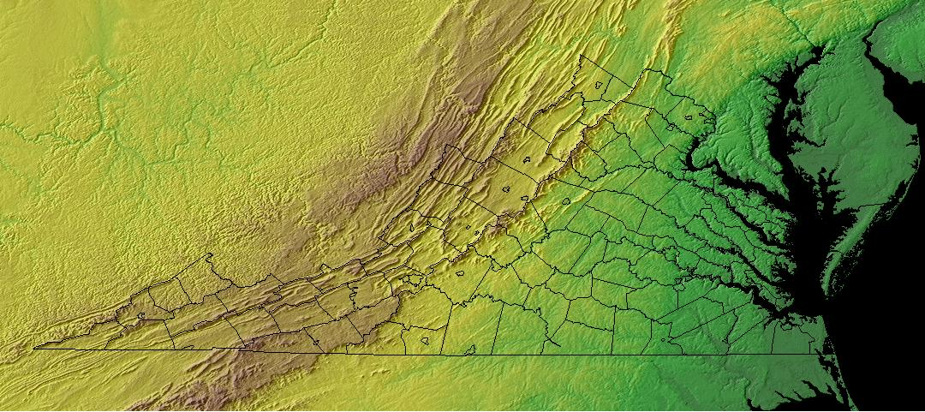
Yet another alternative
What is this an abstraction of?
Who is the stakeholder?
What are its properties?

