Slide 1
Introduction to Computational Thinking
Social Impacts
Nano Project
Create a cohort contract
Explain a model of social impact of computing
Apply this model to a case study
Demonstrate progress on learning objectives via Nano project

Slide 2
Cohort contract
Work in your cohort to write and sign your cohort contract
Finish up in 15 minutes

Slide 3
Knowledge, power, society
Knowledge
Power
systems
models
choices
influence
create
ethics
abilities
Society
Power: “The capacity or ability to direct or influence the behavior of others”
[Oxford Dictionary]

Slide 4
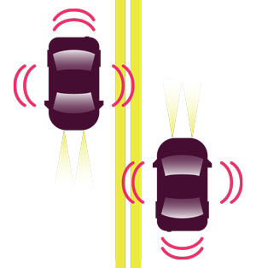
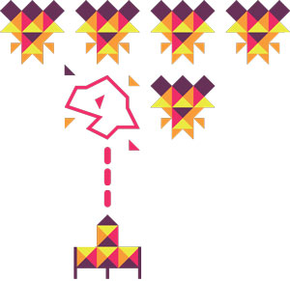
Affecting choices/New abilities
What might be the impact on every day activities of these uses of computing?
Making Headlines Robot Reporters
(2) Letting go of the Wheel
Self-driving cars
(3) Intelligent Play Smart games
(4) For Your Entertainment
Recommender Systems
(5) Fraud prevention Pattern Recognition

Slide 5
Cohort work
Work on the class work for social impacts
Finish up in 15 minutes
Discussion
Discussion of Nano project
Start on Nano project
Explore/identify data set
Think about questions

Slide 6
Nano project
Start on project
See Pages Book - 2.5) Nano Project
Read carefully the rubric explanations
See example project (link at bottom of page)
Requirements
1 – your name and the data set
2 – abstraction
3 – question, visualization, answer
4 – question, visualization, answer
5 – social impacts
6 – Honor code statement
A projects without the honor code slide will be returned ungraded

