Slide 1
Introduction to
Computational Thinking
Analyzing Abstractions
Explain four types of visualization and the questions they answer
Use a visualization tool to ask/answer questions

Slide 2


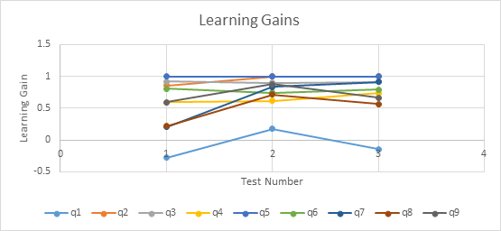
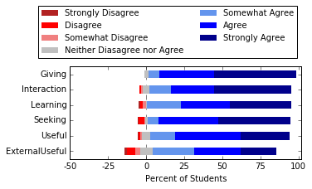
Consent Form
To facilitate use of the class as part of the scholarship to understand and report about teaching and learning at Virginia Tech
Procedures approved by VT IRB to guarantee your anonymity

Slide 3
Reflections
On classwork and homework from last class

Slide 4
Motivation
Abstraction of complex phenomenon too big to comprehend
  Imagine a table for an abstraction with hundreds of properties (columns) and millions of instances (rows)
  Example: U.S. census data
Analysis
  Focus on one or two properties
  Methods
    quantitative measures (later)
    visualizations (now)

Slide 5
Learning Objectives
Explain the application of computational or quantitative thinking across multiple knowledge domains.
Apply the foundational principles of computational or quantitative thinking to frame a question and devise a solution in a particular field of study.
Construct a model based on computational methods to analyze complex or large-scale phenomenon.
Identify the impacts of computing and information technology on humanity.
Analyze an abstraction to answer a question.
Analysis of authentic “big data”.

Slide 6
Simple (graph) visualizations
Visualization
  Engage powerful human visual system
  Show apparent trends, patterns, relationships, etc.
Graph Name | Shows | Number of Properties | Type of Properties
Line plot | trend | 1 | quantitative
Histogram | frequency / distribution | 1 | quantitative
Scatter Plot | relationship | 2 | both quantitative
Bar Chart | comparison | 2 | one quantitative, one categorical

Slide 7
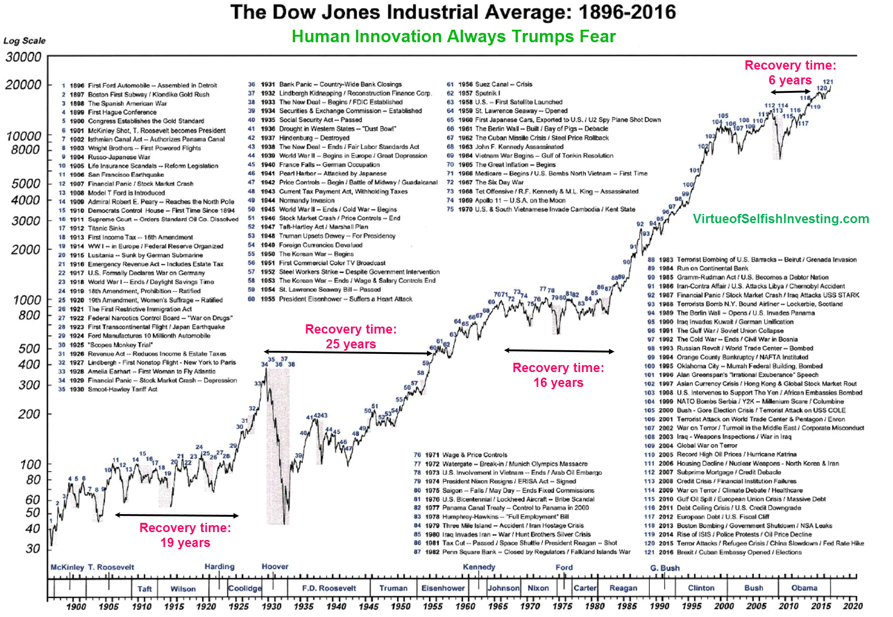
Line plot – trend over time
https://www.marketwatch.com/story/the-dows-tumultuous-120-year-history-in-one-chart-2017-03-23

Slide 8
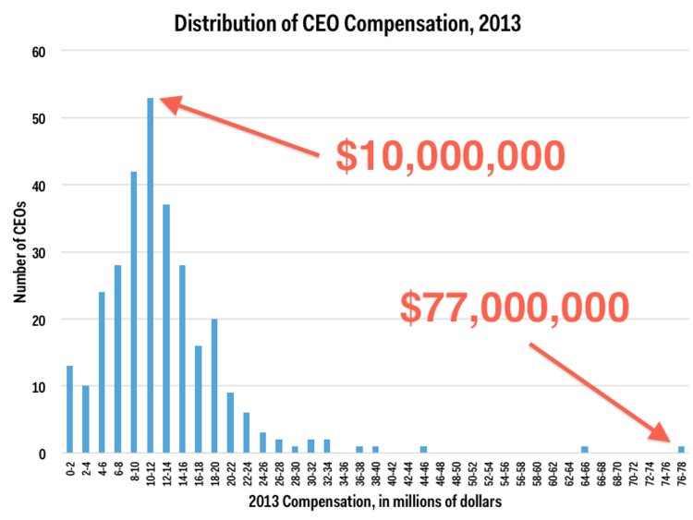
Histogram – frequency/distribution
https://www.businessinsider.in/Pay-Inequality-Is-Massive-Among-Americas-CEOs/articleshow/35690403.cms

Slide 9
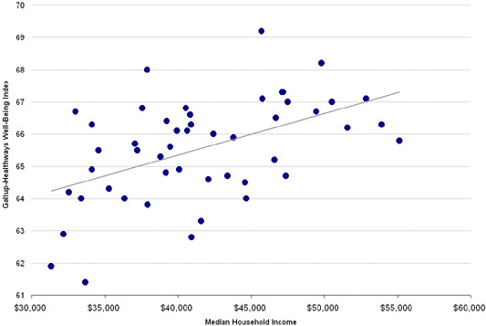
Scatter plot - relationship
https://economix.blogs.nytimes.com/2009/03/10/the-happiest-states-of-america/

Slide 10
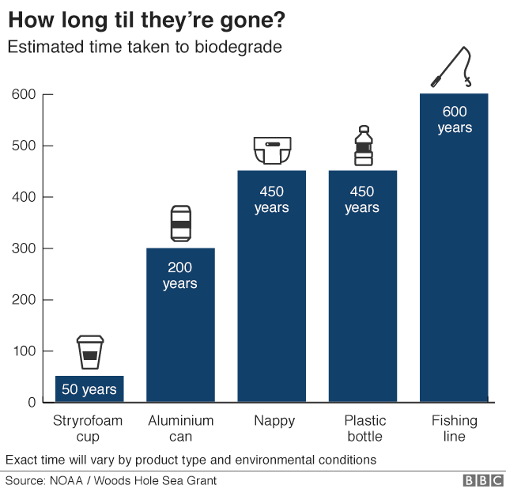
Bar chart - comparison
https://www.bbc.com/news/science-environment-42264788

Slide 11
Careful!
https://venngage.com/blog/misleading-graphs/
https://www.sweetspot.com/en/2015/02/03/education-data-manipulation/

Slide 12
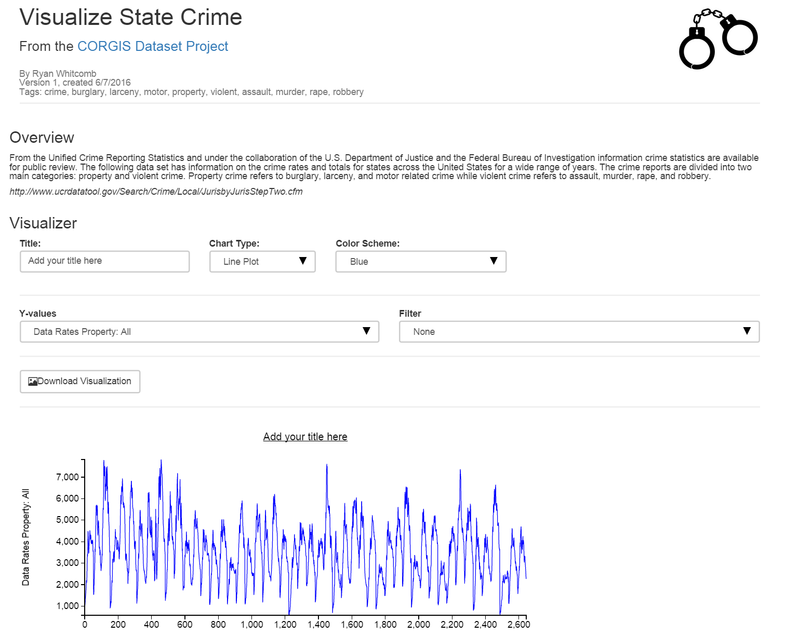
Visualizer
Demonstration

Slide 13
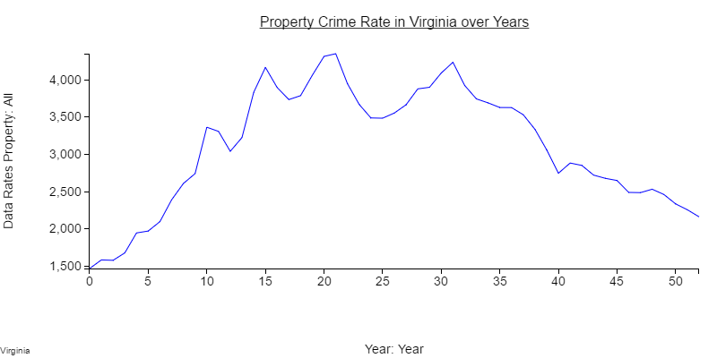
Line Plot
Is there a trend in property crime rate in Virginia over time?
Is there significant variation in the crime rate in different years?

Slide 14
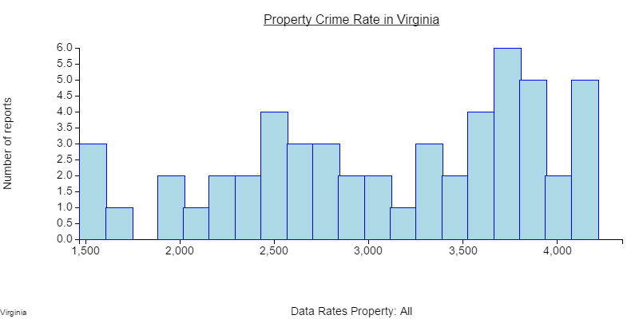
Histogram
What is the most frequently occurring property crime rate?
How many years was the property crime rate between 2,500 and 3,000?

Slide 15
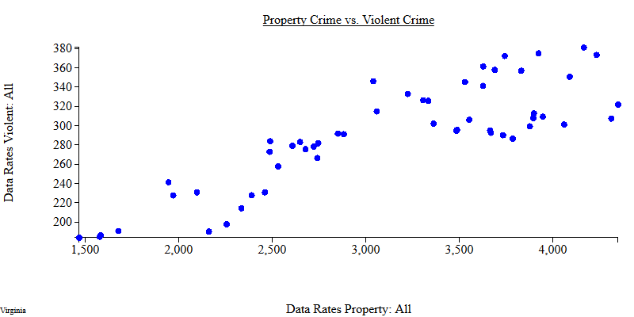
Scatter Plot
Is there a relationship between the rate of property crime and the rate of violent crime?

Slide 16
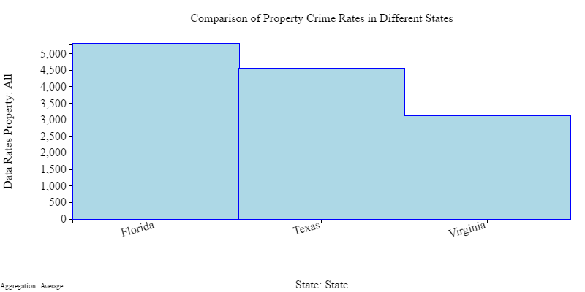
Bar Chart
How does the average property crime rate in Virginia compare to other states?
Does Florida have a higher average property crime rate than Texas?

Slide 17
Histograms vs. Bar Charts
The crime rate in Virginia
Categories
The number of reports that had a crime rate of 4000
Bins (Numbers)

Slide 18
Cohort work
Work as a cohort on the answers to the classwork problems
Discussion: last 10-15 minutes of class

Slide 19
Quantitative Summaries
Simple measures
  Reduce the values of a property to a single number
  Example
    the average household income in the US
    household income is a property in the US census
    Tens of millions of households
Quantitative Summary | Description
count, sum | number (of instances), total (of all values)
average | total divided by number
maximum, minimum | largest, smallest
range | Extent or difference of max and min
threshold | Number above/below given value

