Slide 1
V.T. Student
Earthquakes Data Set

Slide 2
Abstraction
The real-world phenomena of earthquakes is represented by an abstraction that has a number of properties.
The properties used in this project are:
Magnitude – a number (type float) denoting the measure of the earthquake on the Richter scale
Depth – a number (type float) denoting the depth in the earth of the earthquake’s occurrence measured in kilometers (KM)
Only earthquakes in California are used in this project

Slide 3
Quantitative Measure
Question: What is the average magnitude of earthquakes in California?
Answer:
The average magnitude of earthquakes in California is approximately 1.0 (1.006).

Slide 4
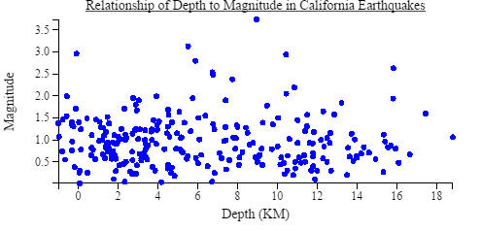
Visualization
Question: Is there a relationship between the depth of earthquakes and their magnitudes?
Answer: As shown in the scatter plot below, there does not appear to be a relationship between the depth and magnitude of earthquakes. That is, earthquakes of a given magnitude can occur at any depth.

Slide 5
Social Impact
Stakeholders
Federal or state agencies
Insurance companies
Emergency response planners
Homeowners and home builders
Impacts
Government regulations, planning, zoning and building codes are affected by knowledge of earthquake characteristics
Homeowners, insurance companies, and home builders are affected by building codes and standards as well as insurance rates for earthquake-prone areas
Conflicts/Pressures
Homeowners, insurance companies, and government planners are under different pressures regarding the costs of building earthquake-tolerant structures.
Emergency response planners and homeowners are under different pressures regarding the property taxes that are needed to provide robust responses to low-probability earthquakes.

Slide 6
Honor Code
I have neither given nor received unauthorized assistance on this assignment.
Signed: V. T. Student

