Slide 1
Introduction to Computational Thinking
Blocks → Text (Python)
State advantages of text programming
Identify correct Python syntax
Create in Python the equivalent to an algorithm in Blocks

Slide 2
Advantages of BlockPy
The drag-and-drop interface means that we do not need to memorize the syntax of statements.
Blockly prevents some kinds of mistakes by allowing only meaningful combination of blocks.
The visual layout of an algorithms can help understand its structure
BlockPy code (nearly) always does something - even when it is not exactly what we want.

Slide 3
Advantages of Python
Write statements (lines of code) faster!
Use the full capability of available programming facilities.
However, we have to learn its syntax.
Keywords: terms or symbols used to indicate the kind of statement being written
Punctuation: symbols or indentation used to indicate the end of a statement or its relationship to other statements
Fortunately, there is a direct relationship between BlockPy and Python!

Slide 4
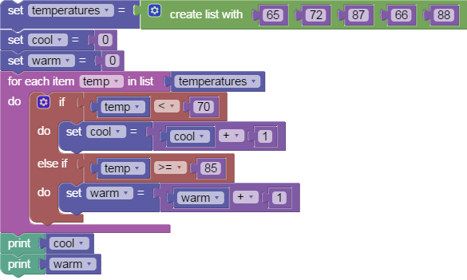
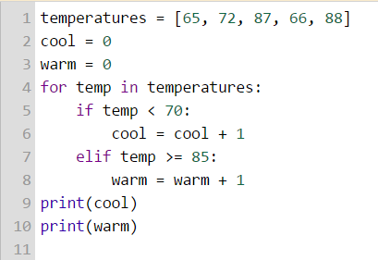
Blocks in Python
click the tab

Slide 5
What’s new/different here?
set temperatures = create list with [65, 72, 87, 66, 88]
set cool = 0
set warm = 0
for each item temp in list temperatures:
if temp < 70:
do set cool = cool + 1
elif temp >= 85:
do set warm = warm + 1
print(cool)
print(warm)

Slide 6
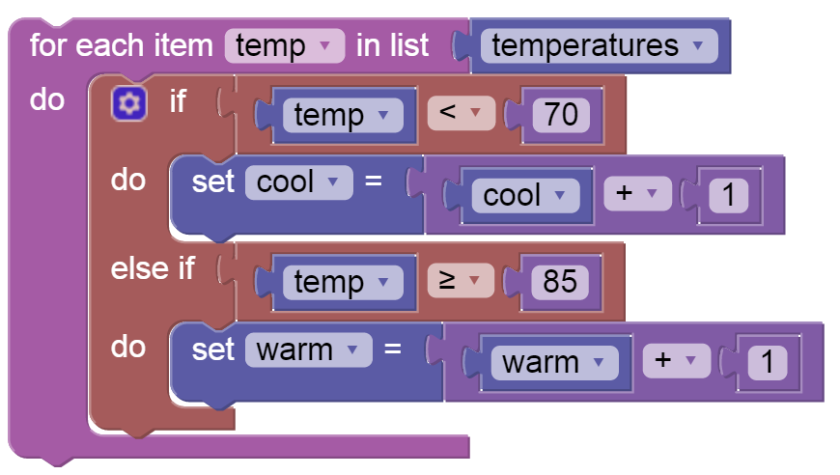
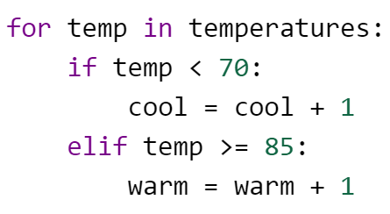
Indentation
4 spaces
8 spaces

Slide 7
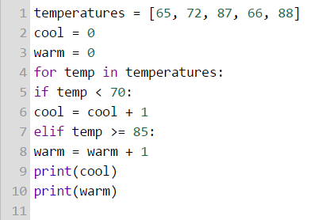
Indentation
Spaces in front of lines of code.
Used to indicate blocks that belong inside another block of code.
The amount of space matters.
What’s wrong with this code?

Slide 8
Colons “:”
Colons at the end of for and if blocks indicate the start of indentation. They are mandatory for these two blocks.
None of the other lines have colons at the end.
temperatures = [65, 72, 87, 66, 88]
cool = 0
warm = 0
for temp in temperatures:
if temp < 70:
cool = cool + 1
elif temp >= 85:
warm = warm + 1
print(cool)
print(warm)

Slide 9
For today
Work on classwork problems in your cohort
This is our first step into Python so don’t worry if it is awkward or difficult
The concepts are the same – only the form is changing!

