Slide 1
Far More Terrible For Women

Slide 2
April 22, 1944 Pauli Murray
Law Student at Howard University
Thompson’s Café
Importance of women to a movement that seems to be male dominated.

Slide 3
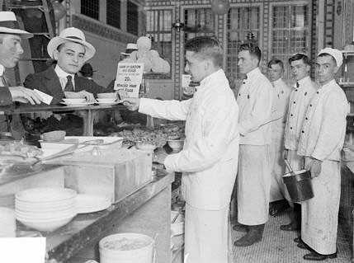
Pauli Murray
Students wouldn’t leave
National Headquarters said the demonstrators could be served
First time blacks were served at a whites only establishment in DC

Slide 4
What does this tell us about the civil rights movement?
Gandhi (Not Dr. King)
16 years later these actions would be employed in non-violent resistant movements
Pauli Murray?
Highlights the connectedness between racism and misogyny

Slide 5
Women During Slavery
Frederick Douglass wrote, “When the true history of the antislavery cause shall be written, woman will occupy a large space in its pages; for the cause of the slave has been peculiarly woman’s cause”.

Slide 6
Far More Terrible for Women
Field work + Domestic Work
Pregnancies (miscarriages)
Constant beatings
The threat/idea of rape by white men

Slide 7
Black and White Women
White women had no rights
Husbands sexual betrayal (mulatto children)
Woman’s Paradox
  White Women – Pure, forced to deny sexual urge
  Black Women – passionate animal
Both ensured male dominance

Slide 8
Black and White Women
White women legally subordinate “cult of womanhood”
Black and white women began organizing
Maria Stewart
  First public lecture given by a woman
  Afric-American Female Intelligence Society
1837 – Anti Slavery Convention of American Women
Harriet Tubman

Slide 9
The Split
14th Amendment – included the word male
15th Amendment – women were excluded once again
White women realized they would not gain their rights through fighting on the behalf of racial equity

Slide 10
The Black Woman’s Dilemma
Women’s Rights Movement
Or
The Black Movement

