Slide 1
Mike Brown and You
Presentation by Conner Margarat Breslau, Morgan Esters, Joseph Frazier, Alexis Harper, and Devon Lee

Slide 2
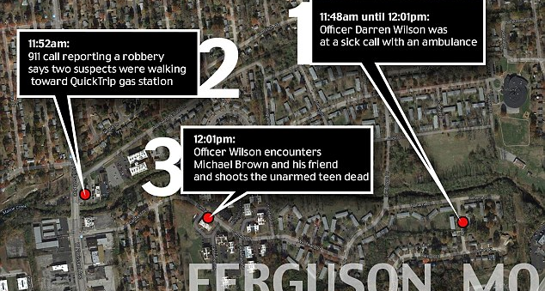
The Beginning
Notes:
On August 9th Michael Brown and his friend Dorien Johnson were on their way from the Ferguson Market and Liquor Store when they were confronted by officer Darren Wilson.
After demands, Furgeson Police Department released the name of the officer involved in the shooting along with a video of a “strong arm” robbery that Brown and Johnson were alleged to commit.
The implicit message was that Brown and Johnson were suspects and prone to violence.

Slide 3

Notes:
So far, we know that Wilson did not stop Brown because he was a suspect, but for “walking in the middle of the street/impeding traffic” (on a Saturday around noon in a suburban community).

Slide 4
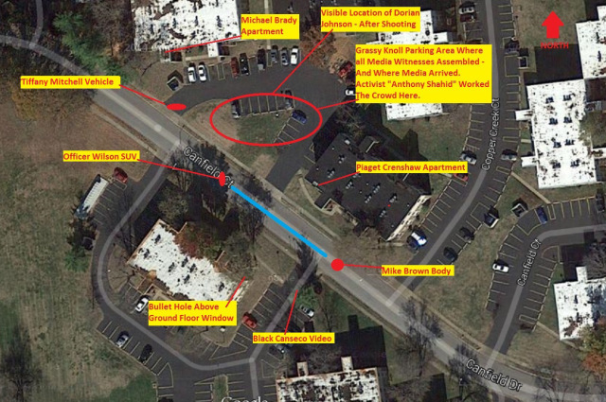

Slide 5
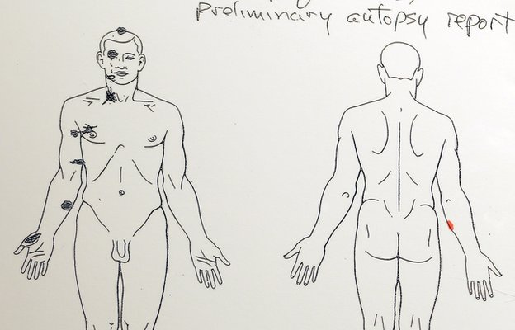
Notes:
The Autopsy and forensic evidence reveals that Brown was shot inside the officer’s vehicle
It is not known whether Brown was being pulled into the vehicle as indicated by Johnson’s testimony or attacked the officer in his vehicle.
The wound on Browns hand indicates that aspect of the altercation.

Slide 6
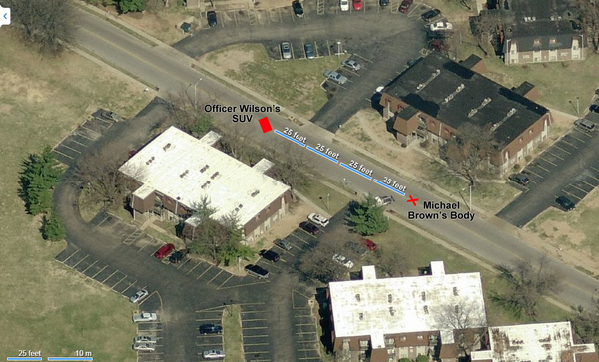
Notes:
Brown being shot over 100 feet away from the officer shows that Brown did flee from the officer after the initial contact.
He was said to be hit by 8 bullets with 2 kill shots to the head after what witnesses say was him surrendering with his hands in the air.

Slide 7
Why We Protest?
97 days and no indictment of Darren Wilson
  This incident conjures a past of (predominantly) white cops killing Black men and women with impunity.
  Brown’s body sat in the hot afternoon sun for 4hrs and 32 minutes before it was carried away in an unmarked SUV.
    This was received as a symbolic message to reaffirm white supremacy, as past lynchings did.

Slide 8
Why We Protest?
Kajieme Powell (Killed on August 21st in St.L)
  Was shot after displaying threatening gestures toward the police officers with a knife.
  The video evidence conflicts with what initial reports indicate, saying that he lunged at officers with an overhand grip.
  With five officers present, non-lethal devices were not employed.
  He was handcuffed after he died.
  Powell was displaying erratic behavior and showed signs characteristic of borderline or anti-social personality disorder.

Slide 9
Why We Protest
Vonderrit Myer’s (Killed in St.L. on October 8th, 2014)
Shooting did not turn up a gun at first and when it did, it did not match the original description that was matched against social media pictures.
  Witnesses say that he was unarmed and that the allegation that he fired at a police officer during a pedestrian stop (racial profiling) was fictitious.
  The original encounter was a “pedestrian stop” which is reminiscent of profiling—and the recent Brown shooting adds to already existing tension.

Slide 10
Why We Protest
According to CDC data (data from 1968-2011), Blacks are (on average) 4.2 times more likely to get shot and killed by a police officer than a white person.
According to Malcolm X Grassroots Movement, a Black person is killed by an officer of the law, security guard or vigilante every 28 hours.
Most officers (and predominantly white individuals acting under the “authority of law”) involved in the over 500 killings of Black people over the last 2 years have not been tried in a court of law…something that Ida B. Wells has been making a record of since 1896.

Slide 11
Testimonies
Margaret Breslau
Devon Lee
Morgan Esters
Joseph Frazier
Alexis Harper
Conner

Slide 12
Questions?
At this time, I would like to open up the floor for audience questions.

Slide 13
But We’re at tech…
Smithfield
Floyd “Hard Times” Meade
State demographics v. student demographics
Underprivileged students tokenized in classrooms
Marginalized graduate students being forced out of their departments after voicing concerns about faculty treatment, methodologies and/or curriculum.
White professors mentoring white graduate students at a higher rate than graduate students of color
Inclusive Excellence is a model, not a plan
  Tech is not too far distanced from its past and it is our obligation to change it, otherwise, we continue the legacy of the devaluation of Black life.
    Tech is not seeming to incorporate a chief diversity officer despite recommendations from Duke, which the model is borrowed from.

