Slide 1
White on Black
The Dark Continent and Colonialism

Slide 2
Topics
Timeline of conquests
Exploration myths and white supremacy
Missionary projects and colonialism
Colonialism and Western Popular Culture
Domination

Slide 3
Objectives
Understand how exploration myths generated a frenzy to rationalize domination
Provide context to how atrocities were rationalized
Give context on how Africans “sold out” their own in terms of political coercion
Understand how racism was a product of the social construction of race.

Slide 4
Timeline of Contact and Conquest
1795 The exploration of the African interior began with the Niger expedition of Mungo Park.
1869 Opening of the Suez Canal
1874 Second British war against Ashanti
1878-9 Zulu war. British defeat at Isandlwana. Start of French operations against the Mandingo empire. Stanley enters the service of Leopold II
1881 French invasion of Tunisia

Slide 5
Contact and Conquest Cont.
1882 British occupation of Egypt
1883-5 Germany claims Protectorates over Togoland, the Cameroons, East Africa, South West Africa
1884 Battle at Omdurman. England claims Somaliland.
1884-5 Berlin Conference
1885 Foundation of Congo Free State by Leopold II. British South Africa Company claims Bechuanaland. England claims Kenya. Italians seize Massawa in Ethiopia
1887 Expansion of English influence in Nigeria.

Slide 6
Myth making
Explorations were also a large source of mythmaking.
The Dark continent came into being only in the nineteenth century as an appropriate stage of décor for European exploration.
Contribution to knowledge were limited because of explorers’ beliefs in racial and patriotic superiority.
The obsession of Egyptology since Napoleon’s invasion of Egypt in 1798 was reflective in beliefs in white supremacy
Egypt civilization was symbolically painted in white face

Slide 7
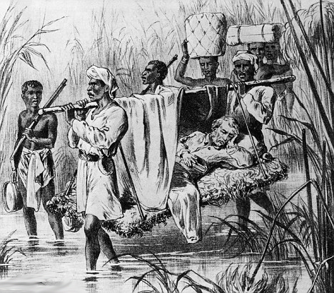

Slide 8
Africans and Indigenous Americans
These contacts typify the experience of the Europeans, and not necessarily the natives. This situation allows myths to proliferate.
Similar to explorations, Africans and Indigenous have been made extras in the portrayal of what should be their story.
Portrayals of Indigenous and Africans were created to rationalize exploitation

Slide 9
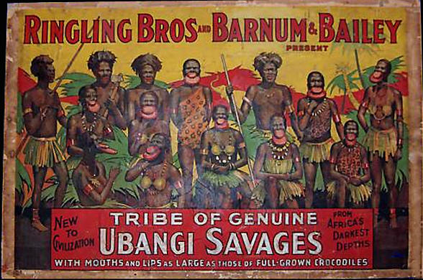

Slide 10
Beliefs in Inferiority
The colonizers saw their disposition as one of superiority, and the colonized as inferior.
This created the notion that the Africans were the White man’s burden.
This goes back to the disappearance theory whereby it is only through the benevolence of Whites that the Africans are to be able to survive as a race.
White man’s burden was used to justify slavery, and colonialism. It was to give racialized “others” civilization and Christianity.

Slide 11
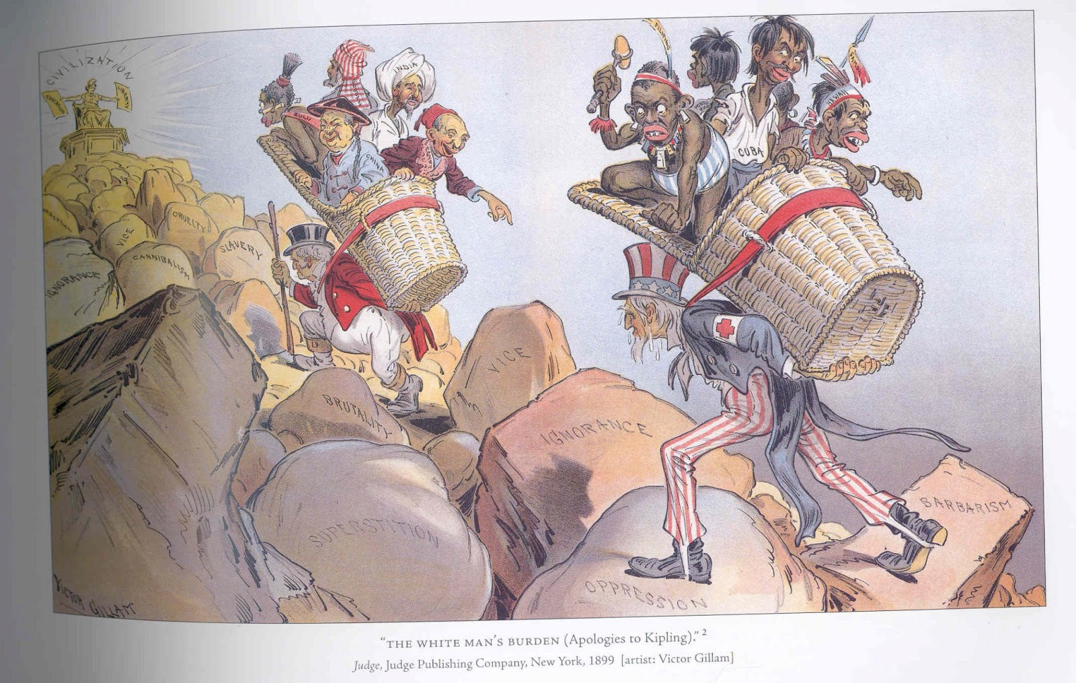

Slide 12
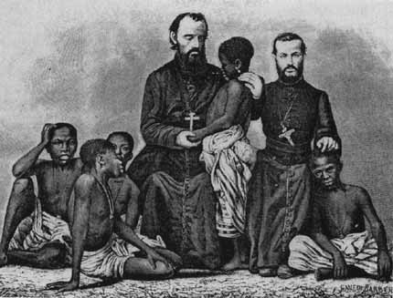
The White Savior Model

Slide 13
Missionary and Colonialism
Portrayals of the missionary hero and evil witch doctor help to rationalize conceptions of inferiority, despite the accuracy of those portrayals.
Heathen worship
Human sacrifice
Animal sacrifice
Spiritual incantations
Were used to invalidate African religions as heathen and African people as a whole as in need of salvation

Slide 14
Missionaries
Attempted to divorce people from their culture and religious traditions.
This was rationalized through the belief that the White man’s mission was to save the Black man from savagery and heathenism.
Myths accompanied beliefs in White supremacy to allow for missionary projects to be used as political projects of domination under the veil of salvation.

Slide 15
White Savior Model
Whites then saw it as their burden to save Black people from themselves in the continent and abroad.
Africans were taught to want to be like their White saviors and to hate their own traditions and values.
Christianity worked effectively alongside colonialism to create a psychic of inferiority through ideological and violent coercion while identify and extracting human and natural resources.

Slide 16
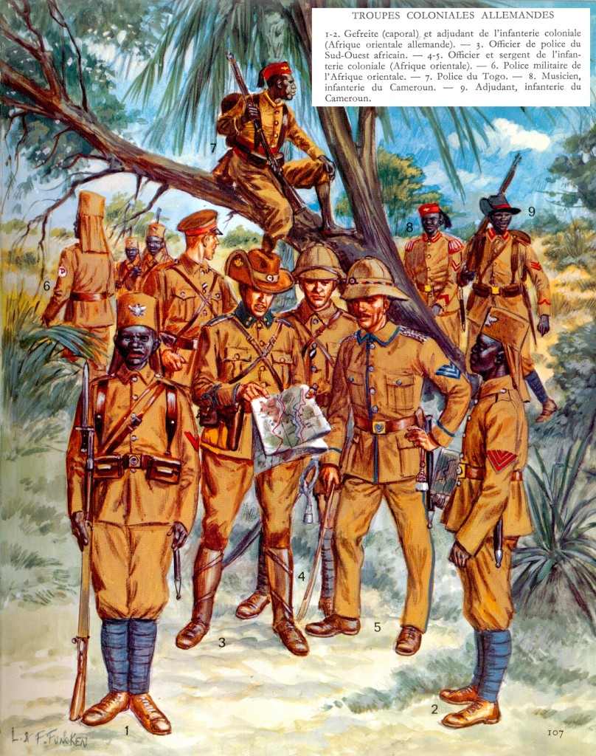

Slide 17
Africans in European Uniform
Early in the 1800s, French recruited Africans, through local chiefs who supplied prisoners of war, as soldiers for conquest.
The ‘Gurkha syndrome’ (joining the conqueror’s Army) is a classic form of ethnic political adaptation.
In all colonies, Europeans used native soldiers.
Propoganda posters went throughout Europe to validate conquests

Slide 18
Western Domination
“I know their game…First traders and missionaries, then ambassadors, then the cannon. It’s better to get strait to the cannon.”
Between 1800 and 1914, Europe’s control over lands went from 35 percent to 84.4 percent.
Africa had been controlled economically by the beginning of the 20th century.
Consider the ideological-political-economic processes that took place.
Gunboat diplomacy utilized trade as a means of control, coercion and colonization.

Slide 19
Berlin Conference

Slide 21
The Scramble
Rivalry for African territory created political conflict between European nations.
National media houses issued propaganda satire depicting the conquests of and by other European powers
This was a scramble for resources coded in beliefs in racial and national superiority
Conflation of race and national identity opposed to perceived otherness and inferiority.

Slide 22
Atrocities in the Congo
Under King Leopold II’s reign, more than 10 million Congolese were brutally murdered
While also being force into labor camps.
This was a product of a larger project whereby savages were to be turned into colonial subjects.
Essentially, people became commodities for European interests while mythologies, prejudices and dehumanization were practiced commonly.
Colonial propaganda then represented a larger project of economic gain, even in terms of humanitarian projects.

