Slide 1
Historical Construction of Racism
What lies behind the veil

Slide 2
Social Construction of Race
Eugene IV
Nicholas V
Columbus
Slavery
Racism as the rationalization for dehumanization oppression.
Industrial Revolution

Slide 3
Objectives
Understand the historical construction of racism.
Consider alternatives to prejudice and bias in understanding racism.
See enlightenment and the industrial revolution that followed as a product of racism.

Slide 4
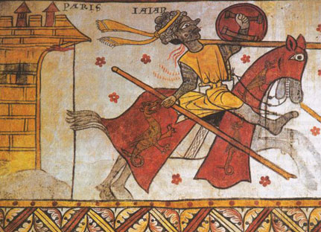
Saracens and the Fall of the Ottoman Empire
Notes:
(711) For about 700 years, Spain and the Iberian Peninsula was ruled by Middle-Eastern and Northern Africans by way of the Ottoman Empire.
In 1325, Alfonso XI takes the city of Grenada that begins in a series of battles ending in 1491 when the Muslims in surrender to Christian forces

Slide 5
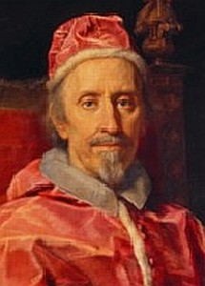
Pope Eugene IV

Slide 6
Eugene IV Papal Bulls
Sicut Dudum (1435) bans the enslavement of the newly Christianized Africans from the Canary islands.
Illius Qui (1442) granted full remission of sins (moral immunity) to all those carrying out military expeditions against “Saracens”.
  This was later expanded to grant explorers spiritual jurisdiction over all lands “to the South” (East and West) of Europe.

Slide 7
Pope Nicolas V
Issues papal bulls Dum Diversas (1452) and Romanus Pontifax (1455) that allow for the domination of lands and people who are considered heathen (non-European) in the age of discovery.

Slide 8
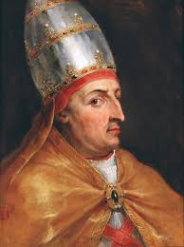
Race in the Age of Discovery
Colonialism in the age of discovery is going to begin the industrial revolution by providing the capital and raw materials to fund the (later) international project

Slide 9
Pope Nicholas V
Dum Diversas and Romanus Pontifax
  1452-1455 Declared that all “non-Christians” were subject to have their land under “Christian dominion” and people enslaved for the development of Christian Kingdoms in the “age of discovery”

Slide 10
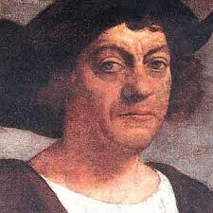
Columbus

Slide 11
Columbus
Columbus sailed the ocean blue in 1492 and began the spread of global exploitation of human and material resources.
  3rd voyage was made to civilize and extract gold.
  Inhumane practices.
    Rape, murder, utilization.
  Enslaved the native population and captured slaves.

Slide 12
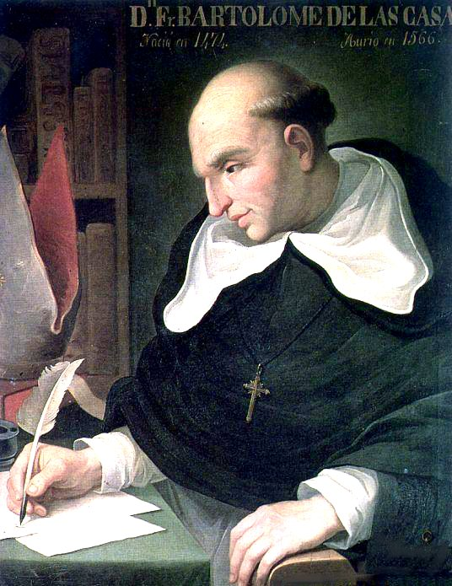
Bartolome’ de las Casas

Slide 13
Bartolome’ de las Casas
Ordained a priest in 1507.
  Witnessed a massacre of Cuban indigenous in 1514 that caused him to renounce his property and preach against the subjugation of natives.
  He dedicated his life to the advocacy of Native rights against subjugation, however, felt that the subjugation of Africans for the economic and territorial gain of Christian kingdoms was a legitimate practice.

Slide 14
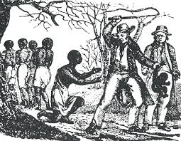

Slide 15
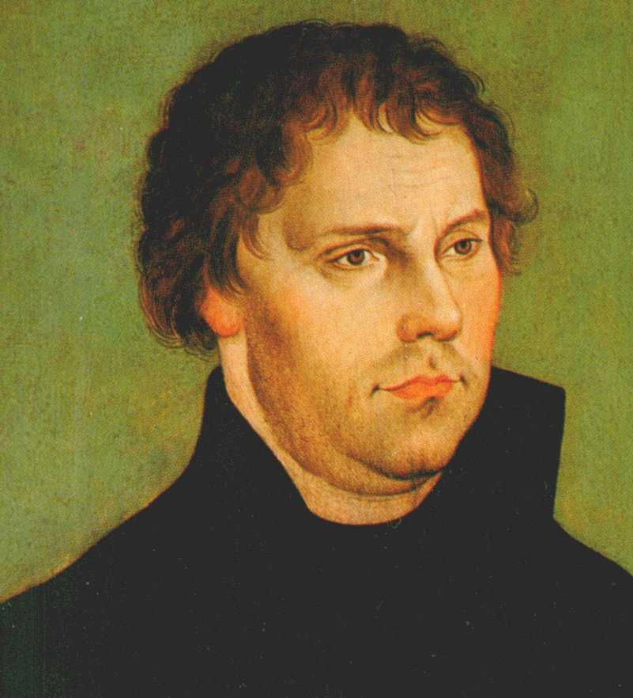
Martin Luther
Notes:
Nailed his 95 Thesis to the Saints Church in Wittenburg Germany calling for the independence (from Catholic rule) of churches, along with a shift from Priest as savior, to Jesus as savior.

Slide 16
Result of 95 Theses: Nascent Colonialism
  This puts political power in the hands of the people, rather than the hands of clergy.
  Political power outside of the church, positions dukes, earls and kings to develop power-blocks never before realized and will begin the development of what we know as nation-states.

Slide 17
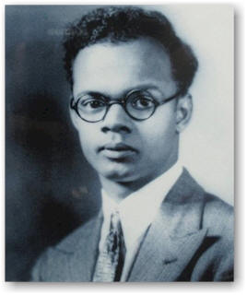
Eric Williams

Slide 18
Eric Williams
Wrote a dissertation called capitalism and slavery where he made the argument that slavery came before racism as a function of the capitalist market and secondary market.
  Rather than create a circular chicken and egg or argument of consecutive engagement (exploitation and ideology happened at the same time). Williams argues that slavery happened as an capitalist project and rationale was later developed as racism.

Slide 19
Enlightenment-Industrial Revolution
In the known as enlightenment, countries were developing into nation-states through the accumulation of capital.
  This is going to be through slavery
As nations were building through resource acquisition facilitated through the age of discovery, people in the Americas and in Africa were dying and being oppressed in massive numbers.

Slide 20
Enlightenment and Freedom Springing From Oppression
Although the “age of enlightenment” espoused ideas of liberty and freedom, it was also an era where regions were in and out of political turmoil and warfare.
The Dutch and Spanish in particular, carried that culture of violence to the West Coasts of Africa in their efforts to subordinate Africans.
  This was particularly done to coerce Africans to capture Africans.
  Indigenous Americans died at such alarming rates that it was more practical to enslave Africans
Notes:
Only Europeanized natives would have access to European rights. Slave trade began in 1502 with the Spanish. And was magnified by the Dutch East Indian Company when it began in 1621
16th century, natives were fifteen times more likely to be enslaved by the ports. But then famine and disease brought by the Europeans killed them off.
African Slaves were the viable alternative.

Slide 21
Industrial Revolution and Nation Building
As the industrial revolution was happening, colonies were developing as satellites of developing European nation-states to supply growing industries.
  The industrial revolution would not have happened had it not been for the exploitation of slaves, extrapolation of raw material from indigenous land, and the political coercion that was inherent to contact with natives.
Notes:
The industrial revolution took place between circa 1750-1850.
This was at the end of the age of enlightenment….

Slide 22
Social Darwinism
After the enlightenment period, and industrial revolution stark inequality was rationalized through victim-blaming rhetoric.
  The scientific community followed suit by applying Darwinist evolutionary theory to understandings of oppression.
  Through Social Darwinism, inequality was presumed to be a result of the inferior taking their rightful place in society.
    This is similar to the religious explanation that God chooses whom should rule: thereby giving dominion to monarchies and similar governance systems.

Slide 23
Social Darwinism Cont.
Black disappeared theorists assumed that Blacks would ultimately die out given the presumption of Social Darwinism that the fittest survive and the inferior die.
  Slavery was then theorized to unnaturally increase the fitness of inferior enslaved populations through the need to keep them alive.
  social scientists believed that natural selection mirrored contemporary social processes. “the same competitive individualism lay at the root of laissez-faire capitalism and became the key to economic development and progress.
This had political ramifications as “spencer, like Malthus, hoped that social science would provide the evidence that discouraged social reform.”
Notes:
“if man evolved from apelike ancestors and there were no “white” apes, then the white race is the most evolved. Thus, the races of color, which Europeans considered culturally and spiritually more primitive, were closer to the nonhuman progenitor, and the white populations of Europe represented the latest and highest form of evolutionary progress
Herbert Spencer made social Darwinism the most popular tract of sociological thought. Natural selection mirrored contemporary social processes.

