Slide 1
From Akan to Afrim
Exodus and the Africans who wrote the Bible
Nana Branchie Darkwa

Slide 2
Objectives
Understanding the whitewashing of biblical figures
Understanding who were the Afrim people of Exodus
Demystify the Writers of the Bible

Slide 3
Christianity as a Form of Social Control
“The philosophy of religion and the concept of God have had a huge mystical hold on the minds and imaginations of people around the world. Through the mystique of religious philosophy and the concept of God, the Christian mystical dimensions to the extent that it has succeeded in even evoking some form of obsession in humans around the world”

Slide 4
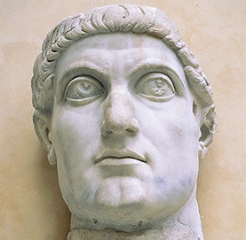
Constantine
Notes:
In his battle against Western Roman Emporer Maxenius at the the Tiber River’s Mulvian Bridge in 312, Constantine was noted to see a vision for a flaming cross that would ensure his victory by Fourth-century historian and bishop Eusebius of Caesarea.
He unified his rule of the Roman Empire in 324, this led to the Christianizing of Rome and thereby the rest of Europe.

Slide 5
The Bible and Reverence
“The bible imposes such an unquestioning soberness and obedience on its believers that most believers do not see where such a sacred and mystical book can be discusses academically.”
To the believers of the bible it is sufficient to know it as the word of God. Who this God is and how he came to be does not matter.
The gaps of knowledge are filled by biased ignorance. Framed by white supremacy…or a white supremacy of knowledge.
“The Bible is in effect caught up in the comparative sociopolitical relationship between Black and White people.”

Slide 6
Difficulty to Locate the Writers of the Bible in Africa
Four Reasons.
The leading Biblical researchers have been Jewish
The research vision is tunneled to fulfill their origin cosmologies
Censorship of dissent as it relates to who authored the Bible
Biblical scholars have ignored the role that Egypt and its descendants played in authorship to the Bible.

Slide 7
What is Left Out
What is left out of the story is the eye witness accounts of non-Europeans who interacted with the people of the bible.
Restricting discussion of the Bible to Biblical text limits an understanding of intentions and writers. Along with historical and cultural context.

Slide 8
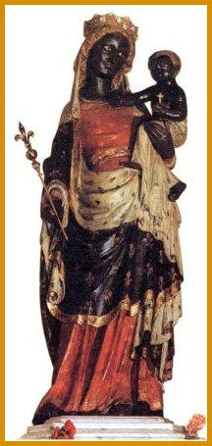
Black Madonna

Slide 9
Black Biblical Figures throughout Europe
Cathedral a Moulins
Church of Annuciata
Church at St. Lazaro
Church of St. Stephen at Genoa
Church of St. Francisco at Pisa
Church at Brixen in Tyrol
Church at Padua
Catholic Cathedral at Augsburg
Church of St. Theodore at Munich in Germany
Borghese chapel of Maria Maggiore
St. Peter’s Basilica

Slide 10
Why Conceal These
The birth of racism caused Europeans to conceal the truth.
The Black figurines were then concealed and put in repositories.
“The racial and ethnic identity of Jesus, his mother, and the people of the Bible are about the true racial and ethnic heritage of the Jewish people and the people from whom they originated before they became the Jews and Hebrews in Europe.”
The expanse of this knowledge base would subtract from ruling ideologies of control and power that dominated Europe at the age of enlightenment.
The Bible was used to command the submission of the people and rationalize the subjugation of non-European racialized people.

Slide 11
Why The Image Needed to Change
The image of Jesus needed to be changed in order for Black people to logically be an exploitable people.
“Modern worshiping of the White images of Jesus Christ, his mother, and the people of the Bible is a perpetuation of the racist sentiments of Christian Europe and Europeans.”
What can we take from this in terms of the racialization of Biblical figures.

Slide 12
What do we know from the Bible
“In Matthew 1:1-17 where the 42 generations of Jesus are traced. Among these generations were four women, there of who were supposed to be Hittites or Canaanites. According to Archbishop Stallings, biblical scholars universally agree that these women: Tamar, Rahab, and Bathsheba, the wife of Uriah, were all Black women. If these three women were Black, what could have been the racial heritage of the rest of the people in the 42 generations of Jesus?”

Slide 13
What we know form the Bible
Jesus was taken to Africa to hide from the murderous intentions of King Herod. If Jesus were White, he could not be taken to Egypt to hide. (Matthew 2:13-15.)

Slide 14
What do We know about Christian Africa?
There was an expansive civilization that stretched over most of the continent and what is now known as the middle-east.
That Africans from Egyptian and Nubian history have a long history and strong presence in the Bible.
Notes:
https://www.youtube.com/watch?v=ZOq5tO9dBd0 Black Pharoas of the 25th.
https://www.youtube.com/watch?v=ZaQiGDZVDz4 Different But Equal

Slide 15
Who are the Writers of the Bible
When we look at Egyptian culture, we see the Nkwa [Ankh] that is a derivative of the Akan language and cultural symbolism.
Afrim is linguistically traced to the Akan people who described their Exodus from Egypt as Fri mu which is contracted as Frim and refers to Afrim when describing the people of the Exodus.
“Judges 12:4-6”→
What is key in this passage was the linguistic test to pronounce a foreign sentence, which demonstrates that these people were phenotypically indistinguishable. The Afrim/Ephraim and the Galatians/Ga people.

