Slide 1
Chapter IV Looking Inward
Intersectinality and anti-essentialism

Slide 2
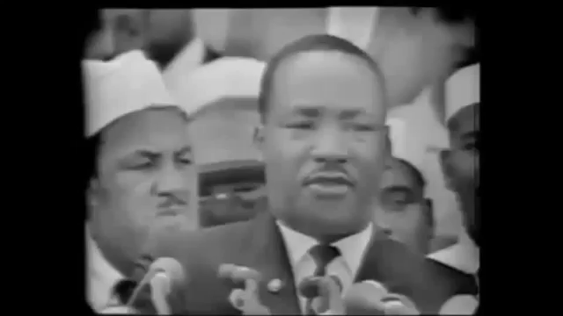

Slide 3
Objectives
Begin to see interplay in your everyday life
Understand how inersectionality positions people to have different lived experience along with different struggles.
Continue to differentiate behavior versus social structures and how they create the outcome of oppression.

Slide 4
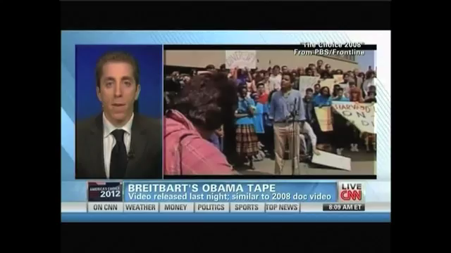

Slide 5
CRT In Action
Outside of law, CRT examines the interplay of power and authority within underprivileged communities and social movements.
  This interplay has nothing to do with individual relationships or ideas.
    In that regard, CRT theorizes that if thoughts and actions of kindness prevailed as common practice, they would have nothing to do with systemic realities: similar to color-blindness as a cure to racism.

Slide 6
Interplay
Interplay: the relationship between power and authority.
Intersectionality: the examination of race, sex, class, national origin, and sexual orientation and how those identities create and respond to societal power differentials.
  Identities can then represent multiple sites of oppression. Ex: poor, gay, Black…etc…
Notes:
Can also represent power and how that interplays with systems of authority, oppression and privilege

Slide 7


Slide 8
Intersection of Domination
Having multiple sites of oppression, prejudice becomes difficult to recognize the complexity of oppressive conditions.
  In given contexts identities create a unique set of penalty and privilege.
    A Black gay woman has three primary identities that are located in one body.
      This particular location of identities creates an intersection of penalties that devalues existence relative to the experience of a strait white man.

Slide 9
Intersectional domination
Individuals must often then choose which identity will be the useful/the most empowered (in given contexts).
This is called shifting.
    Multiple Consciousness-most of us experience the world in different ways on different occasions. If this multiplicity is addressed, social institutions may respond accordingly.
    If multiplicity causes us to shift given different situations of opportunity and oppression, what are the costs and benefits? Can you relate?

Slide 10
Essentialism and Anti-Essentialism
Essentialism:
  All people within a given experience share commonalities, and have common goals and desires.
  Anti-Essentialism: All people within a given group may share variations of a racial experience that exhibits a variation of goals.
    There are no universal identities.

Slide 11
Essentializing.
Reducing something to its most basic elements.
The goals of a “unified’ group may not reflect exactly those of certain factions within it, yet the larger group benefits from their participation because of the increased numbers they bring.
Solutions for oppression have been essentialized in the past by assuming that all forms of oppression are the same.
  Prejudice, bias, cultural practices produce oppressive conditions.
  Essentialization creates an easy solution for a complex problem.
    Ex: assuming that “minorities” represent a collective is a practice of essentializing that has been divisive and undermined solutions for oppressive conditions.

Slide 12
Essentializing Cont.
Essentializing can then be reduced to an understanding of white dominance assuming that race creates an alternative comparative that produces disparities.
  Ex: racism is the result of difference and when people begin to act the same, they will be treated the same.
    This becomes problematic when it assumes that something as basic as group difference, or skin color is responsible for disparities.
    Once the problem becomes defined as such, the solution is also defined as such.

Slide 13
Kind Thoughts Don’t Really Matter
Racism connotes a system of injustice, rather than the result of individual thoughts and action.
  Laws on paper may create safety nets, however they do not prevent disparities.
  Even in Montgomery County, the Black H.S. graduation rate is higher than the White, however Blacks still have a slightly higher unemployment rate.
    Systemic inequalities guide action that lead to disparities.
    Once the system is addressed action will follow and not the other way around.

Slide 14
Historical Abstraction
The abstraction of white-Black creating the common good for all through the Civil Rights movement is a fabrication of reality that undermines social justice.
  White liberals were just as much an impediment to the progress of the Civil Rights Movement as an asset.
  Anti-Civil Rights policy and discourse subtracted from the gains of the Civil Rights movement.
    This was a joint venture between the political left and right majority in an effort to endorse gains that were not reflective of reality through a process of ignoring the impact of systemic racism to market color-blindness.

Slide 15
MLK’s Dream Ab(Sub)stracted
The belief that things have gotten better ignores disparities.
  A lot has changed since the Civil Rights Movement, along with racism.
  However, most indicators of racial disparities have not changed, showing that racism may be just as much prevalent now as it was then.
    One thing to consider: Plessey V. Ferguson was the institutionalization of Jim Crow that marketed itself as “Separate But Equal”
      Equality was an implicit goal unachieved, ultimately undermined by color-blind and color conscious racism

Slide 16
Prejudice and Racism?
The Civil Rights Movement sought to end racism.
  However, systems of injustice prevailed to maintain the previously existing order of racial dominance and subordination.
    Sub prime housing and loans prevented the accumulation of wealth in the Black community, sub prime teachers prevented access to equitable educations, disproportional enforcement in the war against drugs removed potential breadwinners from households, racism in the class room created jail to prison pipelines…it was not prejudice, but a system of inequality that maintained disparities.

Slide 17
Systemic Racism
Systemic Racism: the participation of multiple systems in producing disparities.
  Because racism is systemic, solutions must also be.
  Racism is not intention alone, as has been assumed in the past, it is produced through a larger web of institutional interaction. (will discuss later).

Slide 18
Systemic Racism Cont.
“When we are tackling a structure as deeply embedded as race, radial measures are required. Everything must change at once, otherwise the system merely swallows up the small improvement one has made, and everything remains the same.
  Ignoring intersectionality, as liberalism often does, risks doing things by half-measures and leaving major sectors of the population dissatisfied.
  Classic liberalism has been criticized for holding classic universalisms

Slide 19
Nationalism v. Assimilation
Nationalism: people should embrace their cultural identities and not compromise to the cultural practices of the dominant group.
  Integration is seen to undermine group progress through undermining group solidarity and the racism’s systemic role in producing racial disparities.

Slide 20
Nationalism versus Assimilation
Should we all just be American?
  Would it just be possible for us to just stop talking about racism?
  Is talking about racism so much perpetuating a problem?
    Does difference create conflict?

Slide 21
The Middle Ground?
People of color should not try to fit into the dominant structure, but to transform it.
  Rather than assume that if Whites saw similarities and felt comfortable or had nicer things to think and feel about people of color, underprivileged racial groups should focus on situating themselves in power broking-positions that would allow them to effect change structurally.

Slide 22
The Solution
Some observers hold that all people of color should compromise their differences to form a united front against racism.
  The problem with this solution is that underprivileged races, sexual orientations, socio-economic classes may be better off than others and produce further marginalization.
  The marginalization of the Black woman in the Civil Rights Movement is an example of this.
    They were made to march in the second rows, not allowed to speak for themselves over the race, etc.…and their issues were not addressed as civil rights.

