Slide 1
Introduction to Computational Thinking
Lists and Visualization

Slide 2
Layers of Abstraction
Place | Report | Date
. . . | . . . | . . .
Temperature | Humidity | Wind
76 | 55 | 18
City | State | Zip
Blacksburg | VA | 24061
Month | Day | Year | Time
May | 20 | 2015
Hour | Min | Sec
11 | 32 | 52

Slide 3
Demonstration
Mapping the earthquakes data stream
Using Spyder’s variable explorer
Note: if quakes is a list then quakes[0] refers to the first element of the list

Slide 4
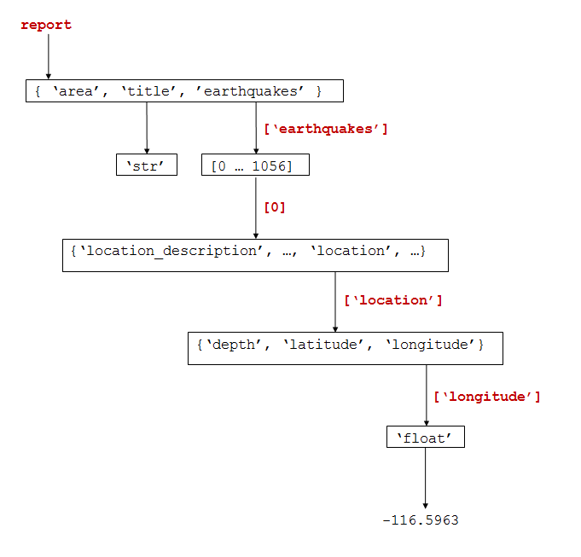
Mapping diagram

Slide 5
Creating a list: example
import earthquakes
# get all the reports of earthquakes of the current day
quakes = earthquakes.get_report('day', 'all')
quake_list = quakes[“earthquakes”]
#create an empty list
significance_list = []
for quake in quakes_list:
# add the significance of the next earthquake to the list
significance_list.append(quake["significance"])

Slide 6
Functions in 3 easy steps
Step 1: functions have names
show() # show the visualization
Step 2: functions may have parameters
plot(data) # plot the list data
Step 3: functions may return a value
val = sqrt(number) # square root
Notes
The user documentation tells you what a function does and what you need to use it
You do not need to know how a function is implemented to use it (and you often don’t care)
Reusing functions is a highly valued professional practice

Slide 7
Four simple visualizations
Name | Function Name | Typical Usage
Line plot | plot(x) | Change of x over time
Scatter plot | scatter(x,y) | Relation between x and y
Histogram | hist(x) | Distribution over range of x
Bar chart | bar(x, y) | Comparison (height of y) over categories of x
Simple statistical measures:
mean (average)
range (min-max)
median (middle value)
More complex statistical measures:
regressions
…..

Slide 8
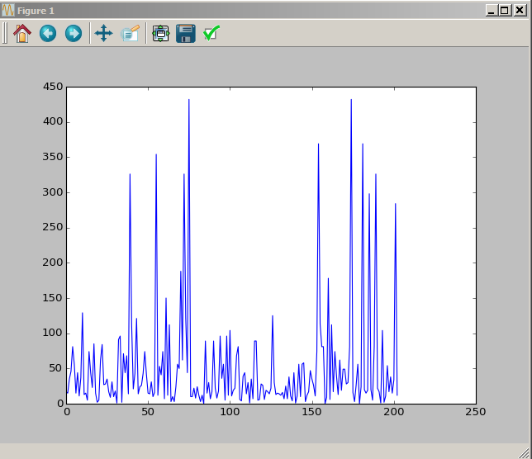
Line plot visualizations
Question: What is the variation in earthquake intensity?
import earthquakes
# get all the reports of earthquakes of the current day
quakes = earthquakes.get_report('day', 'all')
quake_list = quakes[“earthquakes”]
#create an empty list
significance_list = []
for quake in quakes_list:
# add the significance of the next earthquake to the list
significance_list.append(quake["significance"])
plt.plot(significance_list)
plt.show()
Click to save

Slide 9
First, a word about the Project
Component | Content
Abstraction | What does this data represent in the real world?
Questions | What questions are answered by the analysis?
Limitations | What constrains the conclusions that can be draw from this data?
Program Development | How is the program organized?
Visualizations | What graphical representations are made from the data to help in the analysis?
Conclusions | How does the data analysis answer the questions?
Social Impacts | Who is affected by these conclusions? And how?
An example is shown in Chapter 7

Slide 10
Types of questions
Analysis Questions
Characterization questions
What is the distribution of ... ?
What categories of values are there for ...?
What is the range of ...?
How much variation is there in ...?
What is the likelihood of ...?
The proportion falling into a given category is ... ?
Relationship questions
How is factor x related to factor y?
How are factors x, y, and z related?
How does factor x change over time?
Is there a trend in the data?
How is factor x distributed over space?
Constructive Questions
Selection Questions
What is the best match to ... ?
Are there multiple occurrences of ... ?
Are there distinctive categories of ...?
Capability questions
Is it possible for...?
Under what circumstances will ...?

Slide 11
Rubric-based evaluation
Required Element | Missing | Poor | Good | Excellent
The presenter explained the questions to be answered and their importance.
The presenter explained the role of abstraction in defining the information properties relevant to the project’s questions.
The presenter explained the limitations of the available data in answering the questions.
The presenter explained the structure of the data.
The presenter explained the meaning of the visualizations used to answer the questions.
The presenter explained the answers to the questions based on the visualizations.
The presenter explained the social implications of the project.
The presenter communicated effectively.
See description in 7.2) Project - Overview

Slide 12
Next Steps
Work as usual to complete the classwork for today
Homework gives you more practice with these ideas

