Slide 1
Introduction to Computational Thinking
Algorithm
Development

Slide 2
General Ideas
Developing algorithms and program typically involves
building in small steps
frequent checking
finding and correcting mistakes
Mistakes frequently caused by gap between
what we think the algorithm means, and
what the algorithm means to a computer

Slide 3
Warning signs
Just pushing blocks around
Getting the right answer without knowing why
Feeling frustrated

Slide 4
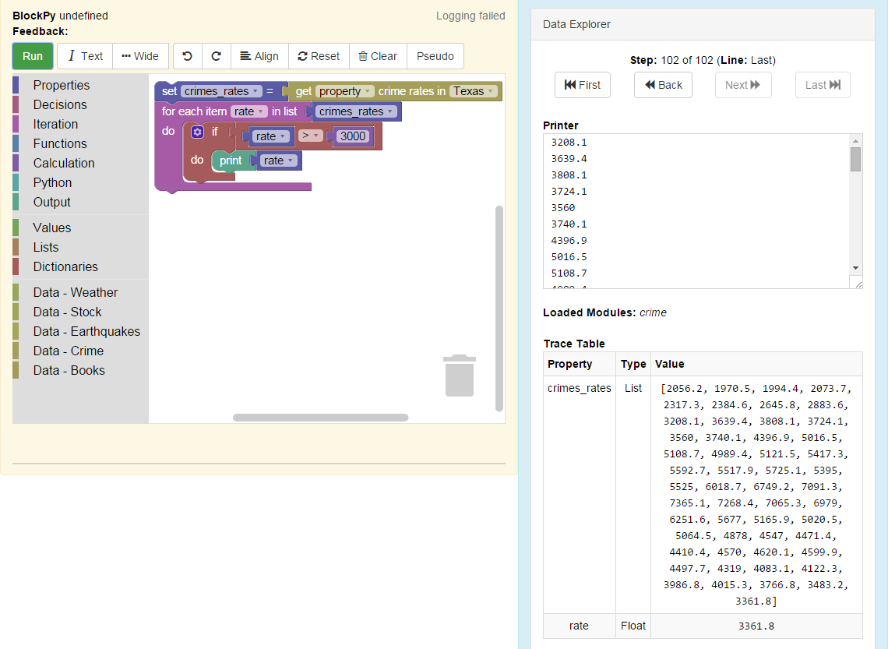
BlockPy features
Pseudo (Englishy description)
Replay
(of last Run)
Trace Table
(properties and values)

Slide 5
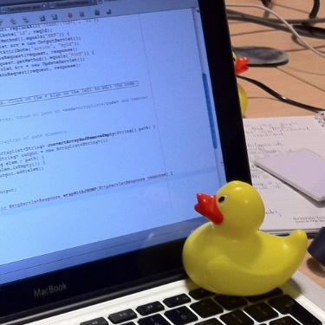
Strategies
incremental development
explaining to another, even an imagined other (“rubber ducking”)
predict what will happen
imagine doing it by hand
test your algorithm with data you make up (on paper, out loud)
Image by Tom Morris - Own work, CC BY-SA 3.0, https://commons.wikimedia.org/w/index.php?curid=16745966

Slide 6
Demonstration
Illustrate the use of BlockPy features and strategies
Develop an algorithm similar to those done as classwork and homework

Slide 7
Next steps today
Complete all of the Blockly and Big Data problems assigned to date
Work as an individual
Seek help from and provide help to your cohort
Go as far and as fast as you can remembering to keep everyone in your cohort on board
Cohort feedback/reports
Discussion

