Slide 1
Introduction to Computational Thinking
Blockly
Lists & Iteration

Slide 2
Things we are seeing
Using lists to represent a data set
Blockly blocks for iteration
Using iteration to process a data set (i.e., a list)
Different patterns for processing a data stream
Uniform
Accumulate
Filter
Transform

Slide 3
Patterns
Uniform: perform the same processing on each element of the list
Accumulate: determine a property of the list
Filter: use a decision to select some elements of the list for processing
Transform: produce a new list by processing the elements of an existing list

Slide 4
Filter pattern
Motivation: in big data only certain occurrences may be of interest
Big earthquakes
Temperatures above or below a certain threshold
A high or low crime rate
Mechanism: combine
iteration – to provide each element one at a time
decision - process each element that passes the test

Slide 5
Filter pattern
iteration
Basic step
A
true
Test A
Process A
false

Slide 6
Transform pattern
Motivation: generate a “transformation” of the abstraction being processed
Create a list of forecast temperatures in Celsius from a list of temperatures in Fahrenheit.
Create a list of “feels like” temperatures from a list of weather forecasts that give temperature and wind speed.
Create a list that categorizes each state’s crime rate as high, medium, or low from a list of crime rates by state.
Mechanism: combine
iteration – to access each element of the existing list one element at a time
lists – create a new list and add items to it

Slide 7
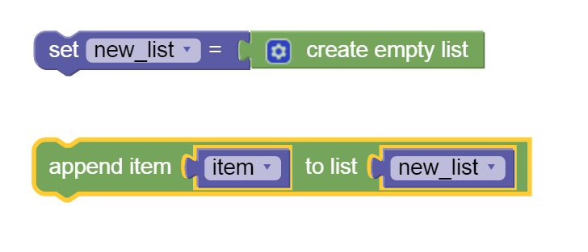
Transform pattern
Creates a new list based on an existing list
Uses list operations
create an empty list
append a new item to end of a list

Slide 8
Transform pattern
iteration
Existing List
A
Process: A -> B
New List
B
append

Slide 9
Next steps today
Work on the assigned Blockly and list problems in the book using iteration and decision
Work as an individual
Seek help from and provide help to your cohort
Go as far and as fast as you can remembering to keep everyone in your cohort on board
Cohort feedback/reports
Start looking at data streams
http://think.cs.vt.edu/datasets/python/

