Slide 1
Introduction to Computational Thinking
Blockly &
Big Data

Slide 2
Things to see today
Blocks for programming (decision, iteration, calculation, state)
Blocks that provide representative slices of actual “big data” sets
Blocks that produce visualizations
Examples of Blockly programs for manipulating the data streams

Slide 3
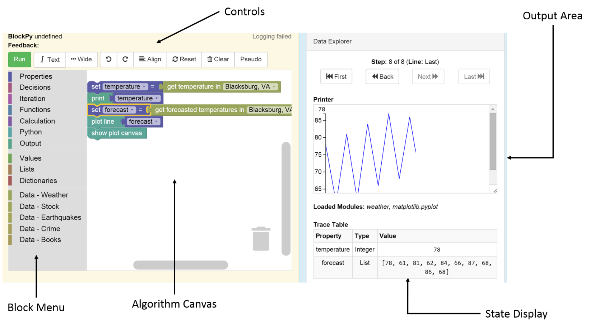
Blockly Environment

Slide 4
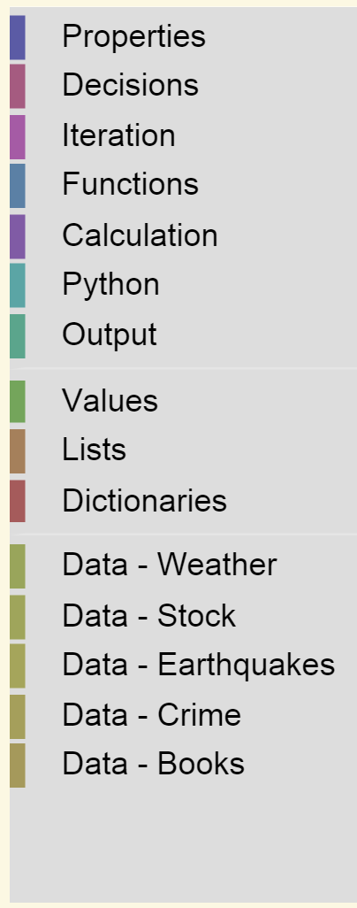
Categories of Blocks
algorithm components
data organizations
“big data”

Slide 5
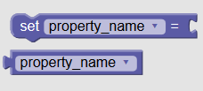
Blocks Used Today

Slide 6
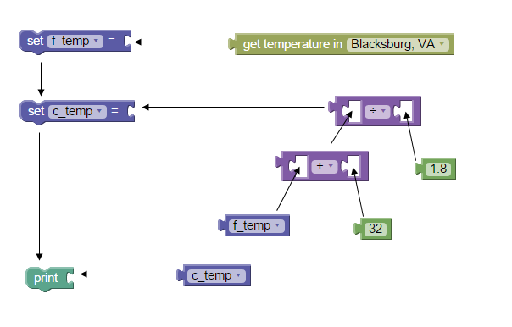
Composing blocks

Slide 7
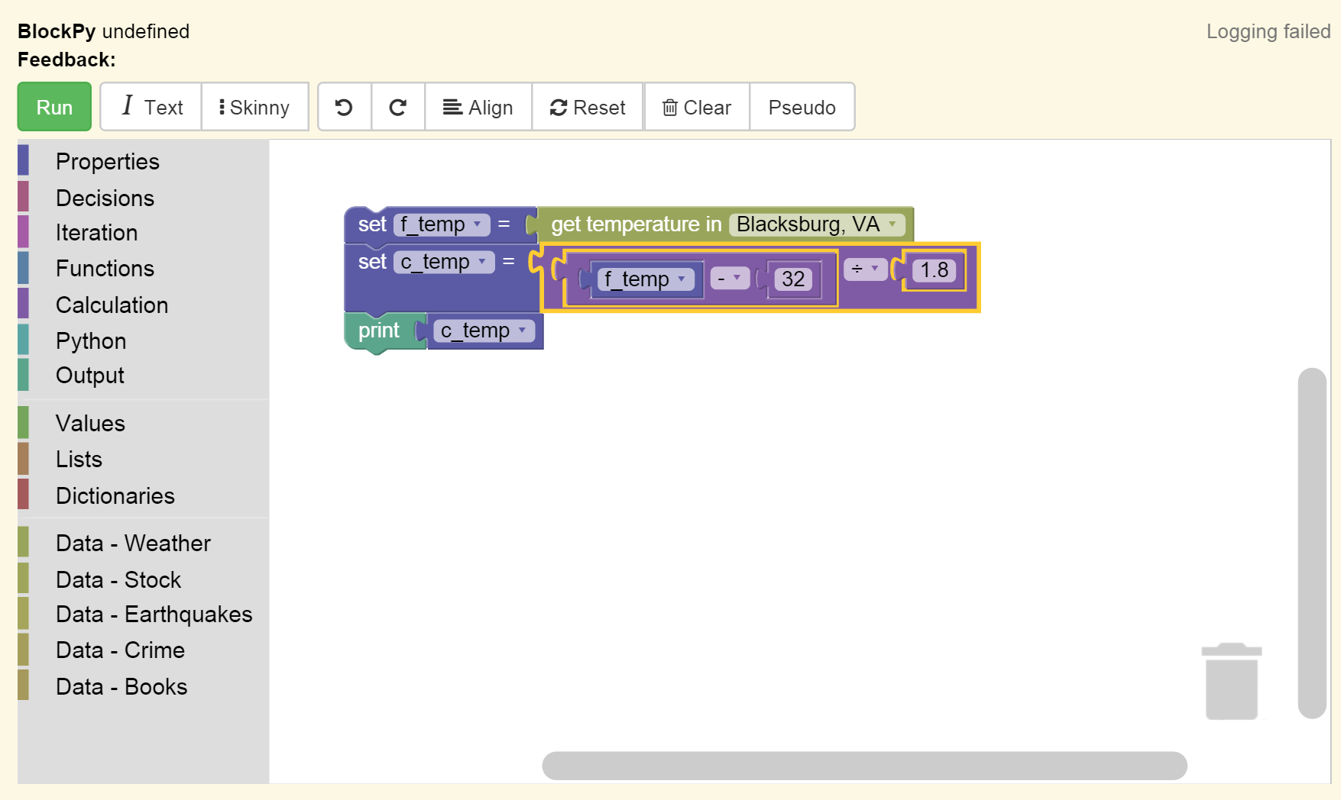
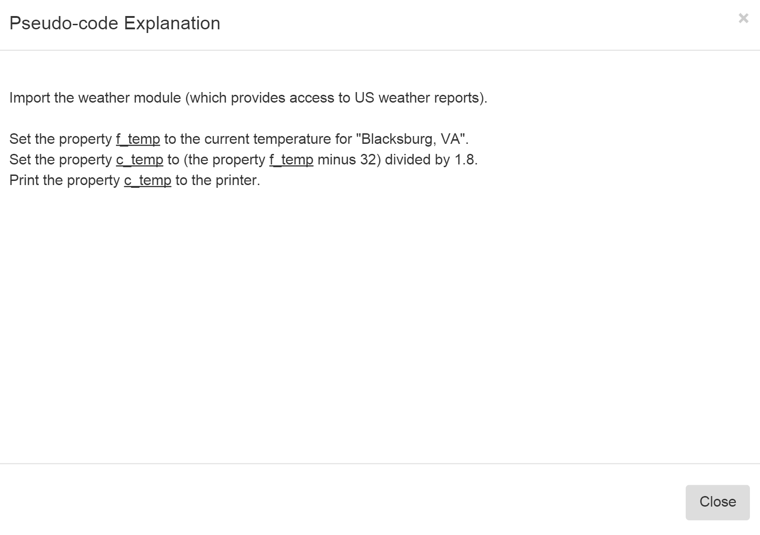
Getting and explanation
Pseudo

Slide 8
Demonstrations
Block manipulations
Output of data streams
Manipulation of data
Output of data
Plotting of data

Slide 9
Next steps today
Work on the assigned Blockly and Big Data problems in the book
Work as an individual
Seek help from and provide help to your cohort
Go as far and as fast as you can remembering to keep everyone in your cohort on board
Cohort feedback/reports
Discussion

