Slide 1
Introduction to Computational Thinking
Abstraction

Slide 2
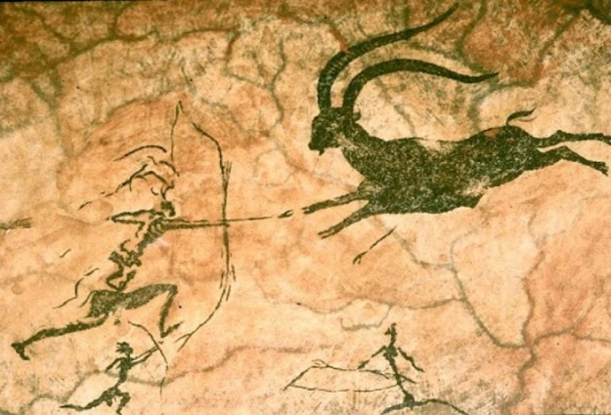
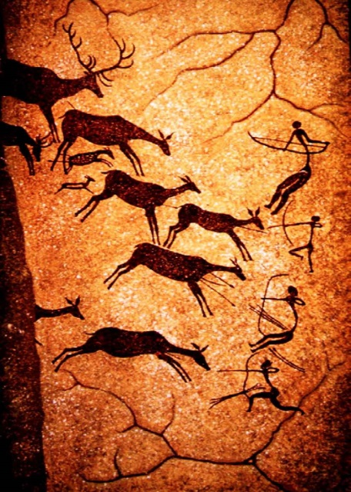
Abstraction
Humans have always used abstraction to model and understand the world
With computers we can form abstractions using a new medium – information.
Information abstraction is one of the two “big concepts” of computational thinking
Information abstractions can be manipulated via algorithms (the second “big concept” of computational thinking)

Slide 3
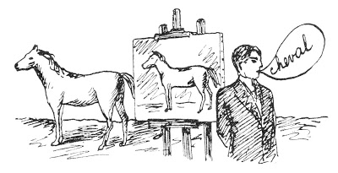
Magritte and abstraction
The Treachery of Images
“An object never serves the same purpose as its name or its image.”
Rene Magritte

Slide 4
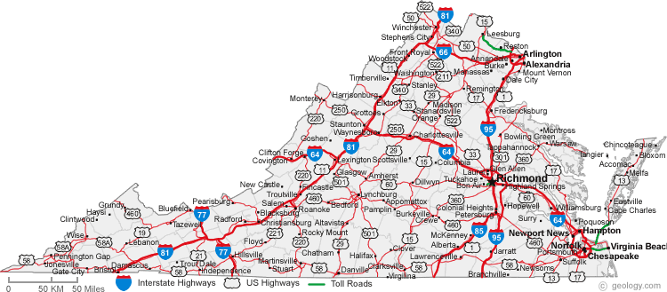
Familiar abstractions
What is this an abstraction of?
For whom (aka. stakeholder) is it designed?
What are its properties?

Slide 5
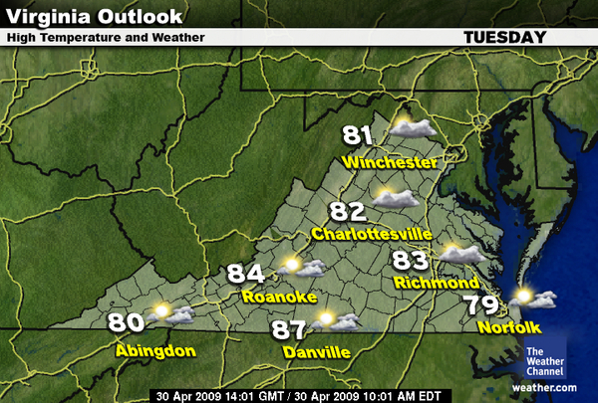
Alternative view…
What is this an abstraction of?
Who is the stakeholder?
What are its properties?

Slide 6
Information Abstraction
Maps are physical abstractions of physical things
We can also form information abstractions of physical things
An information abstraction is
A set of properties relevant to a specific stakeholder
Each property
Is objective and observable
Is named
Recorded in quantitative terms (numbers, characters, codes, categories)

Slide 7
Representing Abstractions
name
stakeholder
description
Movie On-Line Customer
Title |  |  | Genre
Gone With the Wind |  |  | Drama
properties
instances
values

Slide 8
Example
Movie On-Line Customer
Title | Year | Length | Genre | Format | Price
Moneyball | 2011 | 133 min. | Sports | Blueray | $15.00
Gone With the Wind | 1939 | 219 min. | Drama | DVD | $10.95
Jurassic Park | 1993 | 127 min. | SciFi | DVD | $12.50
Pirates of the Caribbean | 2003 | 143 min. | Comedy | Blueray | $17.50
Sicko | 2007 | 116 min. | Documentary | Streaming | $11.75

Slide 9
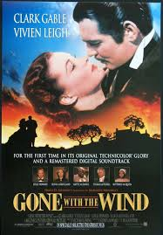
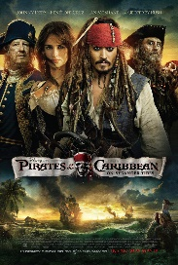
Correspondence
Each instance corresponds to a single real-world entity.
Movie On-Line Customer
Title | Year | Length | Genre | Format | Price
Moneyball | 2011 | 133 min. | Sports | Blueray | $15.00
Gone With the Wind | 1939 | 219 min. | Drama | DVD | $10.95
Jurassic Park | 1993 | 127 min. | SciFi | DVD | $12.50
Pirates of the Caribbean | 2003 | 143 min. | Comedy | Blueray | $17.50
Sicko | 2007 | 116 min. | Documentary | Streaming | $11.75

Slide 10
Cohort work and Reports
Complete the representation of the abstractions distributed at your table.
Report back in 20 minutes.
Class discussion.

Slide 11
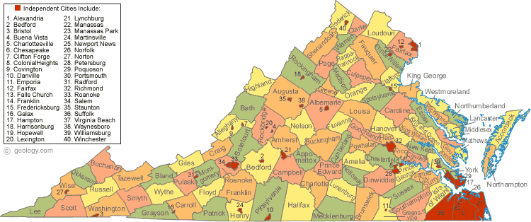
Alternative view
What is this an abstraction of?
Who is the stakeholder?
What are its properties?

Slide 12
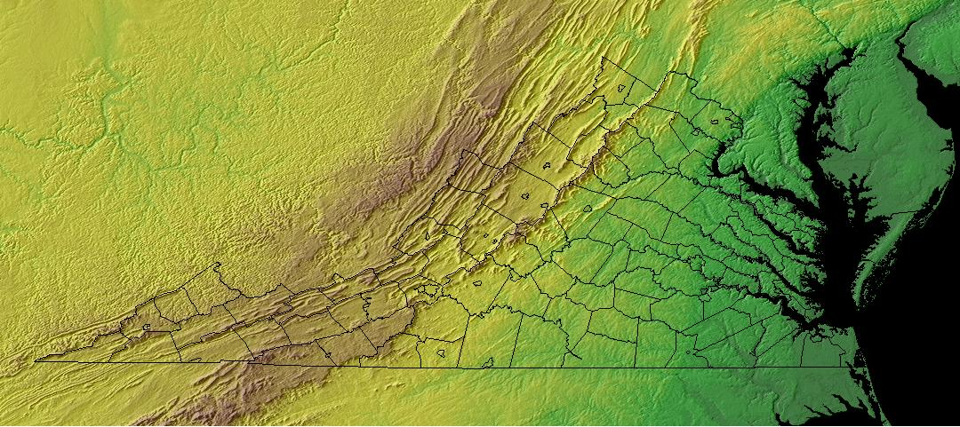
Yet another alternative
What is this an abstraction of?
Who is the stakeholder?
What are its properties?

