Slide 1
Introduction to Computational Thinking
Welcome!!
Dennis Kafura
(GTA, UTA, CTO, Researchers)

Slide 2
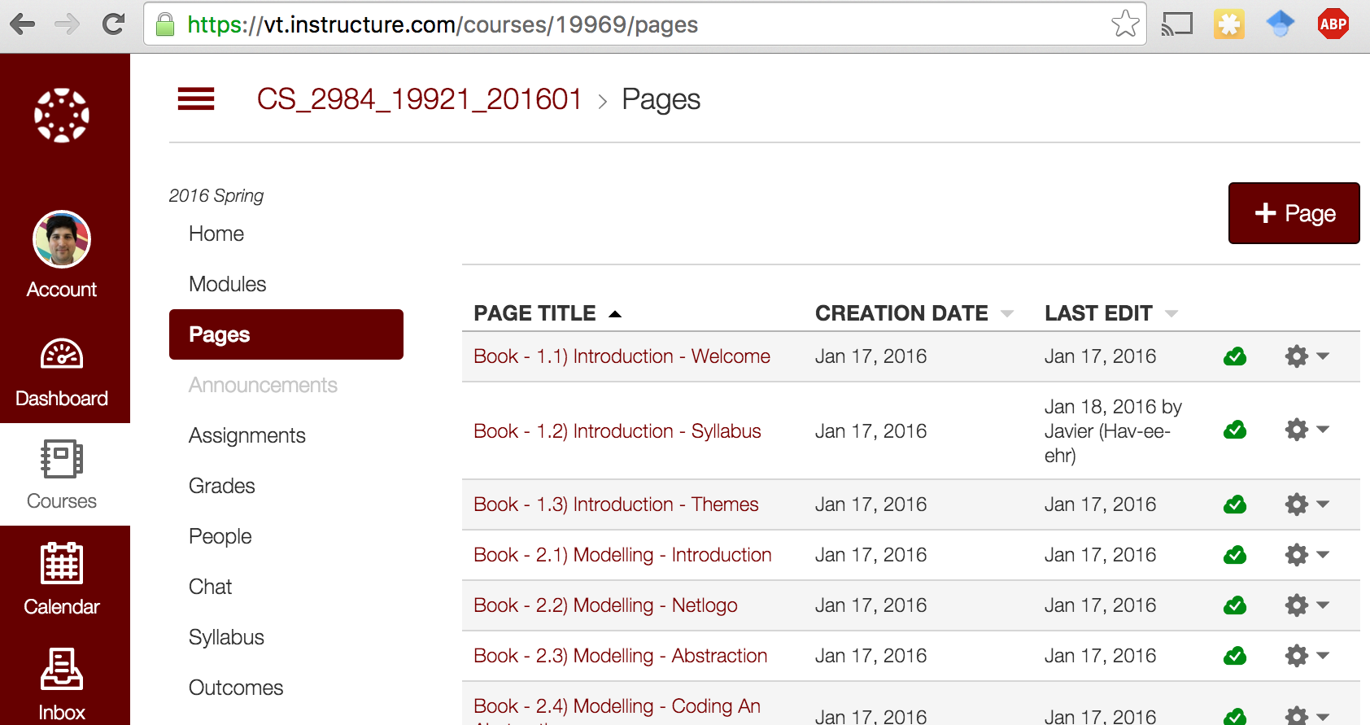
Get the Book
Log in to: vt.instructure.com

Slide 3
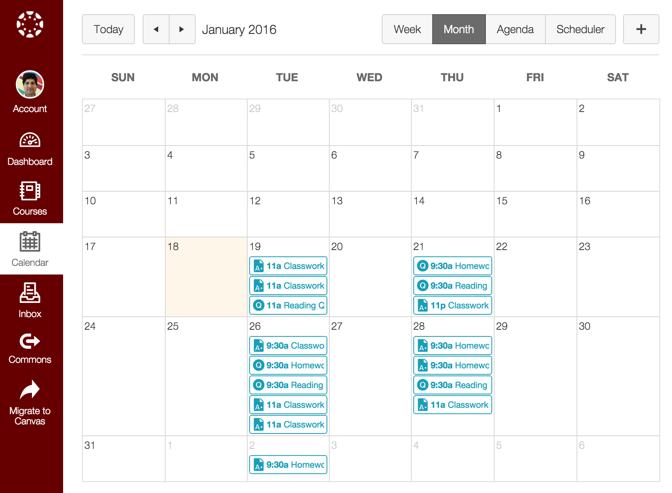
Welcome Page - Schedule
Canvas has the readings, classwork, homework and surveys organized by due date

Slide 4
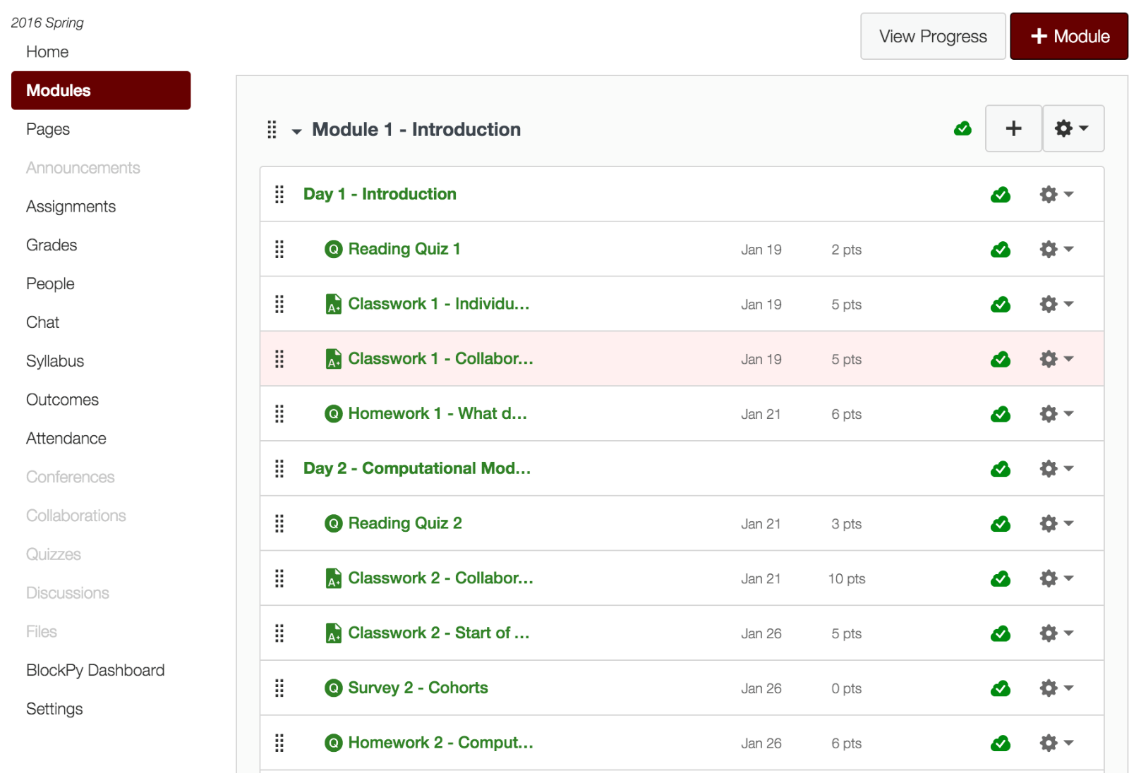
Module page – Contents
Class Day
Reading
Homework

Slide 5
Lets Get Started
Take Reading Quiz 1
Reading Quizzes
This first “reading” quiz ask for some initial thoughts on the class
Future quizzes will ask questions about the assigned reading for the day.

Slide 6
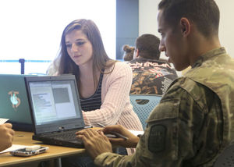
Everyone can succeed
Each critical concept is seen three times in different contexts – you just need to get it once
Relaxed fit grading – make a good faith effort to do all course work and you will get at least a B-. B’s are easy too. A is just a step more.
Some important assignment are “reflections” – there are no right/wrong answers; just be conscientious
Support from your cohort
Project
You propose
A month to work on

Slide 7
Syllabus
Assignment | Percent | Evaluation
In-class work and homework | 60% | This work is evaluated based on a credible effort to complete each assignment.
Project | 20% | This month-long project is evaluated by a rubric assessing the quality and completeness of the project.
Attendance | 10% | This work is evaluated by recorded attendance.
Reading Quizzes | 10% | This work is evaluated by credible effort to demonstrate understanding of the required readings.
The due data for the final project is 8:00AM on Monday, May 2, 2016.

Slide 8
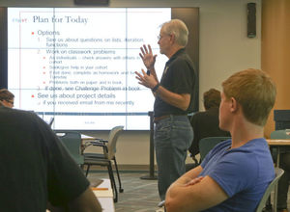
What it takes to succeed
Be conscientious and consistent in
Take the Reading Quiz before each class!
Meet deadlines for homework. Homework assigned in one class is due by the start of the next class.
Attend class to engage in active learning. We will keep attendance.
Ask questions
other students in the class
your “cohort”
the UTAs
the instructors

Slide 9
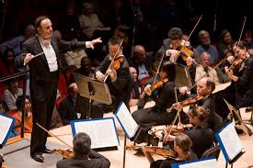
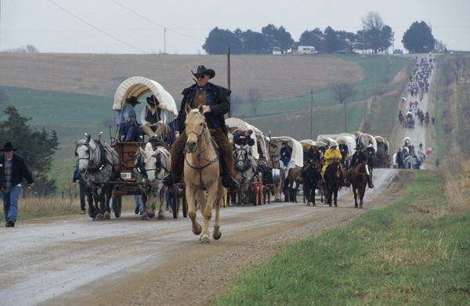
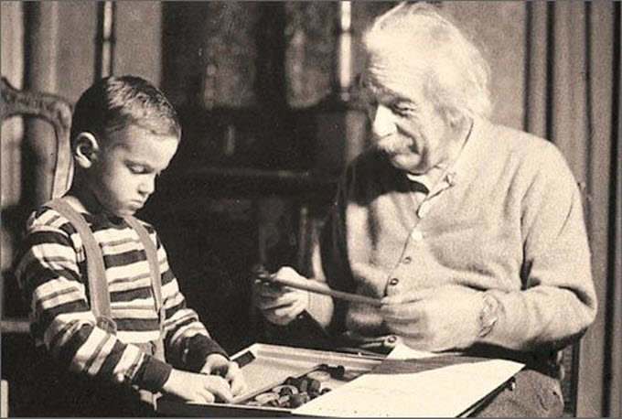
Role: Instructor and UTAs
conductor
guide
mentor

Slide 10
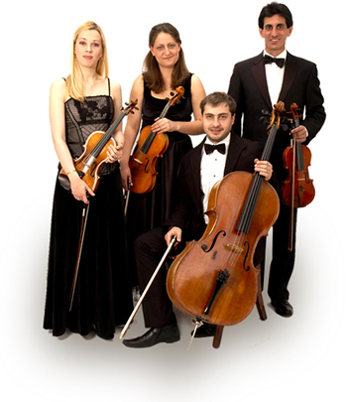
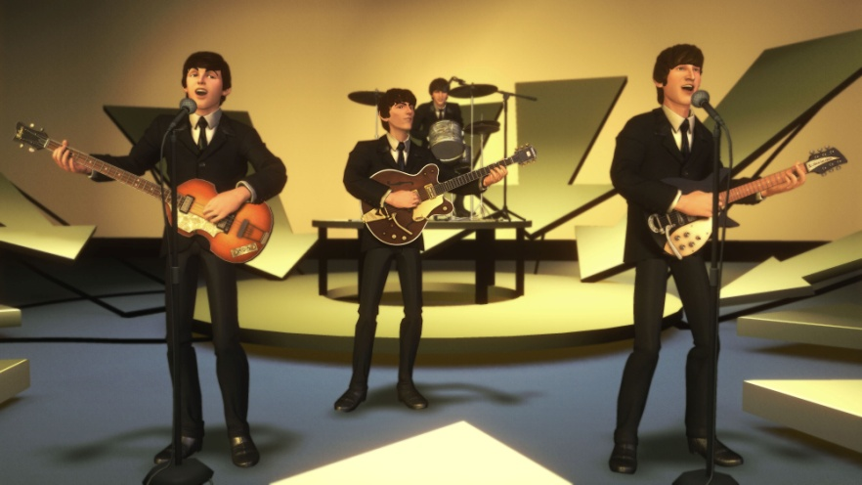
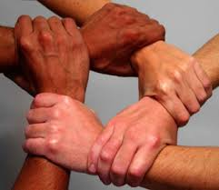
Your Role
Work effectively together in your cohort
Your cohort is a support group
In-class work
Specific assignments
General support

Slide 11
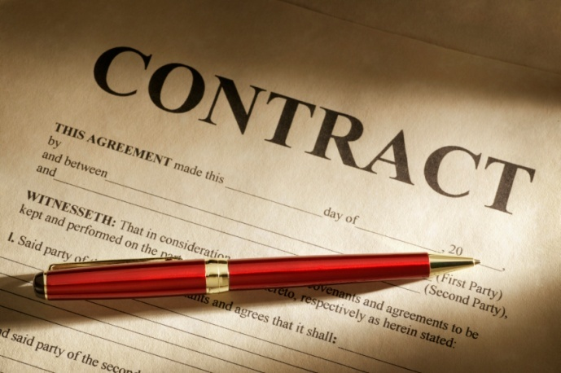
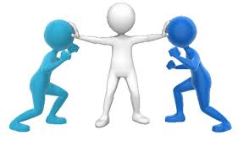
Cohort Contract
Want this!
When you cohorts are formed
(next week) you will write a
contract that sets some guidelines
for your interactions.
Not this.

Slide 12
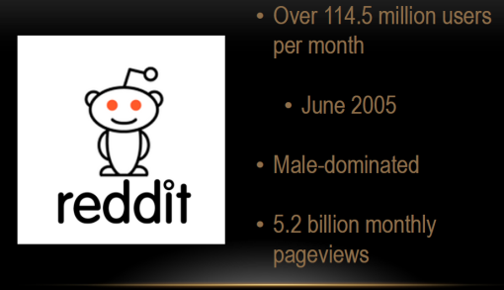
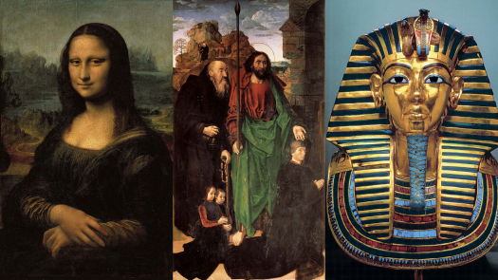
What you will be able to use

Slide 13
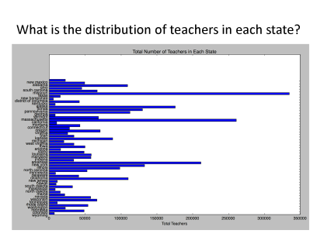
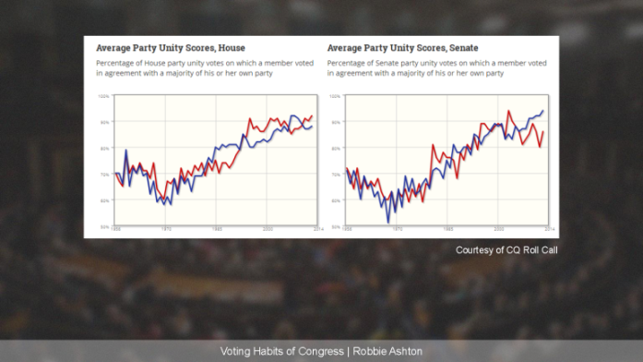
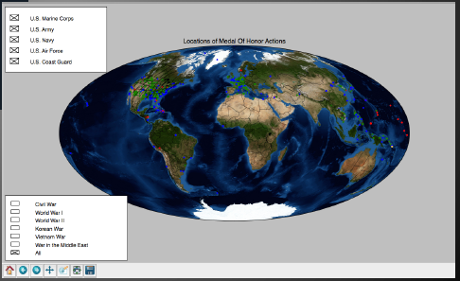
What you will be able to create

Slide 14
For Today
At your table discuss and answer together the questions distributed on paper. Nominate someone at your table to report for your table.
Report back in 25 minutes.

Slide 15
What is Computational Thinking?
Computational Thinking = abstraction + algorithms
Representing a thing by its properties.
Manipulating the properties of things by a precise set of rules.

Slide 16
What’s the plan?
Social Impact & Ethics
Length | Topic | Using
2 weeks | Overview abstraction algorithms social impacts | NetLogo & Blockly
4 weeks | Abstraction & Algorithms | Blockly
4 weeks | Big Data & Mini-Project | Python
4 weeks | Project | Python
The due data for the final project is 8:00AM on Monday, May 2, 2016.

Slide 17
Class is a research project
This is a new class in the Quantitative and Computational Thinking general education requirements (also satisfies old Area 5)
We study the class as part of the scholarship of computing education research
To improve the class and to demonstrate the innovations at Virginia Tech
We ask your consent to allow us to use data and observations about the class as part of our study
Consent is voluntary and in no way affects your participation in the class or your grade
Next class we will have a form for you to sign

Slide 18
Prepare for next class
Do homework and reading
Take Reading Quiz 2 before the next class
Check out NetLogo
Runs in your browser
http://www.netlogoweb.org/launch
Explore a few models

