Slide 1
Introduction to Computational Thinking
Installing Python

Slide 2
Installation Directions
Step 1 – Get files
Insert USB drive
Copy two things to desktop
Computational_thinking
And one of…
PC – Anaconda-2.3.0-Windows-x86.exe
MAC - Anaconda-2.3.0-MaxOSX-x86_64.pkg
Eject USB Drive

Slide 3
Installation Directions
Step 2 - PC
Run Anaconda file
Click, Next, I Agree, Select Just Me/Next, Install
Step 2 – Mac
Be sure you are connected to the network
Run Anaconda file
Continue, Continue, Agree, Install for me only/Continue, Install

Slide 4
Use
All the Python code you develop MUST be in the computational_thinking folder.
You can place this folder wherever you want
Remember where you put it!!

Slide 5
Spyder
1) Open it up
Windows: “Start Button” -> “Programs” -> “Anaconda” -> “Spyder”
For convenience, you can drag the “Spyder” to the desktop or right click to pin it to the taskbar
Mac:
Javier will help you create a shortcut to spyder
Alternatively, if Javier isn’t there, you can use the “Launcher” – can take a little while on some machines
2) Set up your Global Working Directory (next slide)

Slide 6
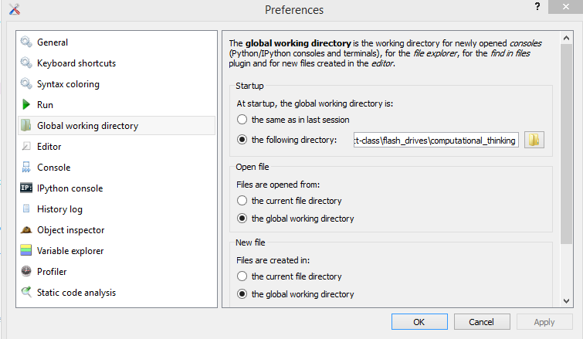
Global Working Directory
In Spyder, just the first time you start…
Windows: Tools -> Preferences -> Global Working Directory
Mac: python -> Preferences -> Global Working Directory

Slide 7
Saving things
Always save everything to your “computational_thinking” folder
When you open up spyder, it makes a temporary file. Open a new file instead, and immediately save it to your “computational_thinking” folder.

Slide 8
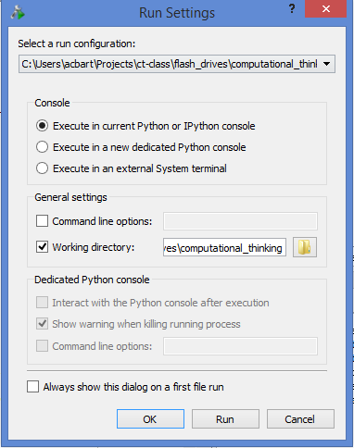
Running things
Click the green triangle in the top left.
“There is no python console selected”
Click the “IPython console” tab in the bottom right before you run.

Slide 9
Next steps today
Complete installation
Check with us if you have problems
Complete Coursework and Homework exercises for today and previous days

