Slide 1
Introduction to Computational Thinking
Manipulating
an Abstraction (Iteration)

Slide 2
An algorithm with iteration
START
BOOK LIST = get all books
TOTAL = 0
for each BOOK in BOOK LIST
grab next book
no more books
TOTAL = TOTAL +
current BOOK’s price
print TOTAL
END

Slide 3
Combining iteration and decision
START
BOOK LIST = get all books
TOTAL = 0
for each BOOK in BOOK LIST
grab next book
no more books
true
BOOK’s price > $40
false
print TOTAL
TOTAL = TOTAL +
current BOOK’s price
END

Slide 4
Abstraction and Big Data
Abstraction identifies the properties of interest of some kind of artifact (books, people, …)
We are not interested in the abstraction of a single instance (one book, one person,…) but a large number of instances of that kind
Examples:
Big Data set … | each instance has…
All Books on Amazon | Author, title, price
All Movies on NetFlix | Title, rating, length
All Stocks on NYSE | Name, price, date, time
All Temperatures in US | City, state, temperature

Slide 5
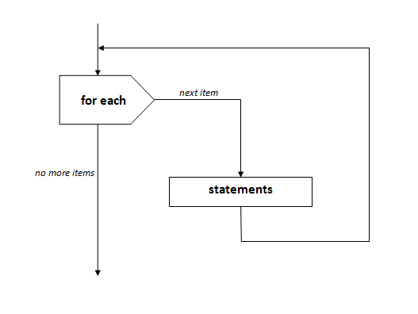
Iteration and Big Data
Definition
repeatedly executing a set of statements
where some data is different on each execution
until a condition changes
If it works for a few items it will work for millions of items!!
AKA: looping, repetition

Slide 6
Example
Temperature abstraction
Temperature data set
City:
State:
Temperature:
City: Miami
State: FL
Temperature: 89
City: New York
State: NY
Temperature: 86
City: Blacksburg
State: VA
Temperature: 77
City: Los Angeles
State: CA
Temperature: 100
City: Ames
State: IA
Temperature: 65
Iteration can be used to process a data set
Each element is processed once
Each iteration applies the statements to the “current” element
The iteration continues as long as there are more elements remaining that have not been processed

Slide 7
Flowchart
City: Miami
State: FL
Temperature: 89
City: New York
State: NY
Temperature: 86
City: Blacksburg
State: VA
Temperature: 77
for each
element
statements

Slide 8
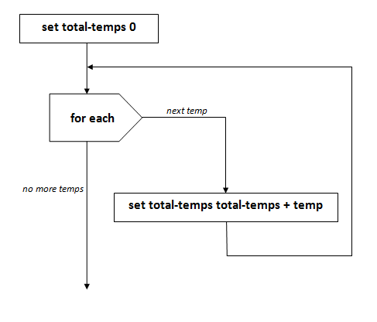
Example
City: Miami
State: FL
Temperature: 89
City: New York
State: NY
Temperature: 86
City: Blacksburg
State: VA
Temperature: 77
City: Los Angeles
State: CA
Temperature: 100
City: Ames
State: IA
Temperature: 65
Find the total
of all of the temperatures

Slide 9
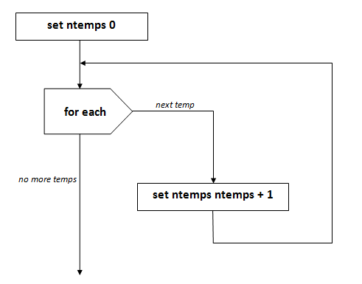
Example
City: Miami
State: FL
Temperature: 89
City: New York
State: NY
Temperature: 86
City: Blacksburg
State: VA
Temperature: 77
City: Los Angeles
State: CA
Temperature: 100
City: Ames
State: IA
Temperature: 65
Find the total number of temperatures

Slide 10
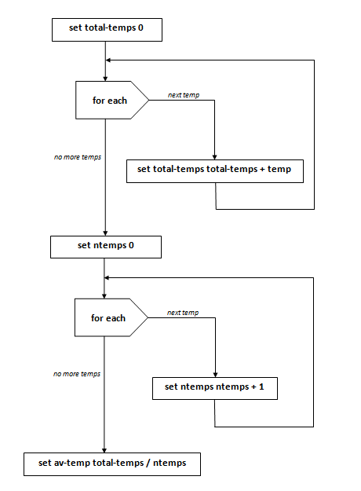
Combining iterations
Find the average temperature:
average = total/number
Iterate to find total
Iterate to
find number

Slide 11
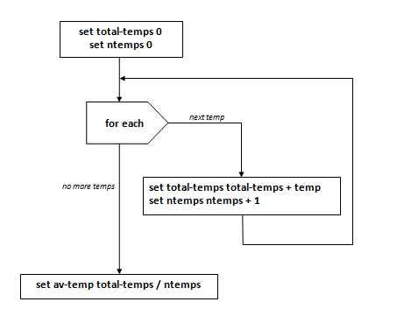
Combining iterations
Find the average temperature:
average = total/number
combine steps
one iteration

Slide 12
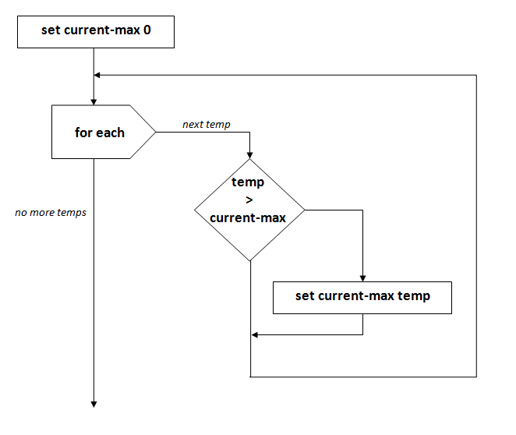
Iteration and Decision
Find the maximum temperature.
set current-max 0
for each city [
if temp > current-max [
set current-max temp
]
]

Slide 13
Next steps today
Work on the iteration problems in your cohort
Exchange algorithms for problem 2
Cohort feedback/reports
Discussion

